Slide 1
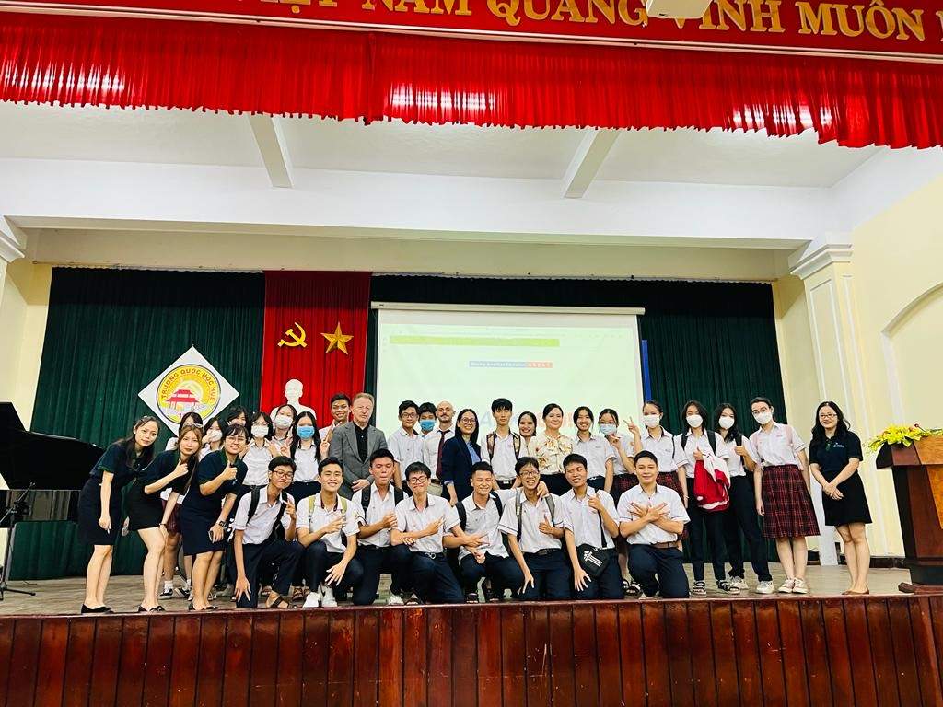
A Decade of Promoting Greenville High School Around the World
Robert Stanger
American Education Pathways

Slide 2
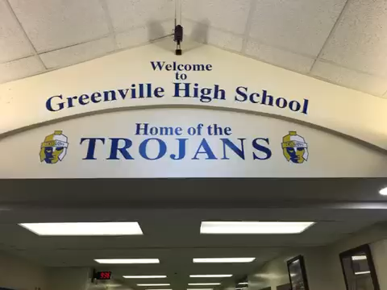
Welcome to Greenville, PA

Slide 3
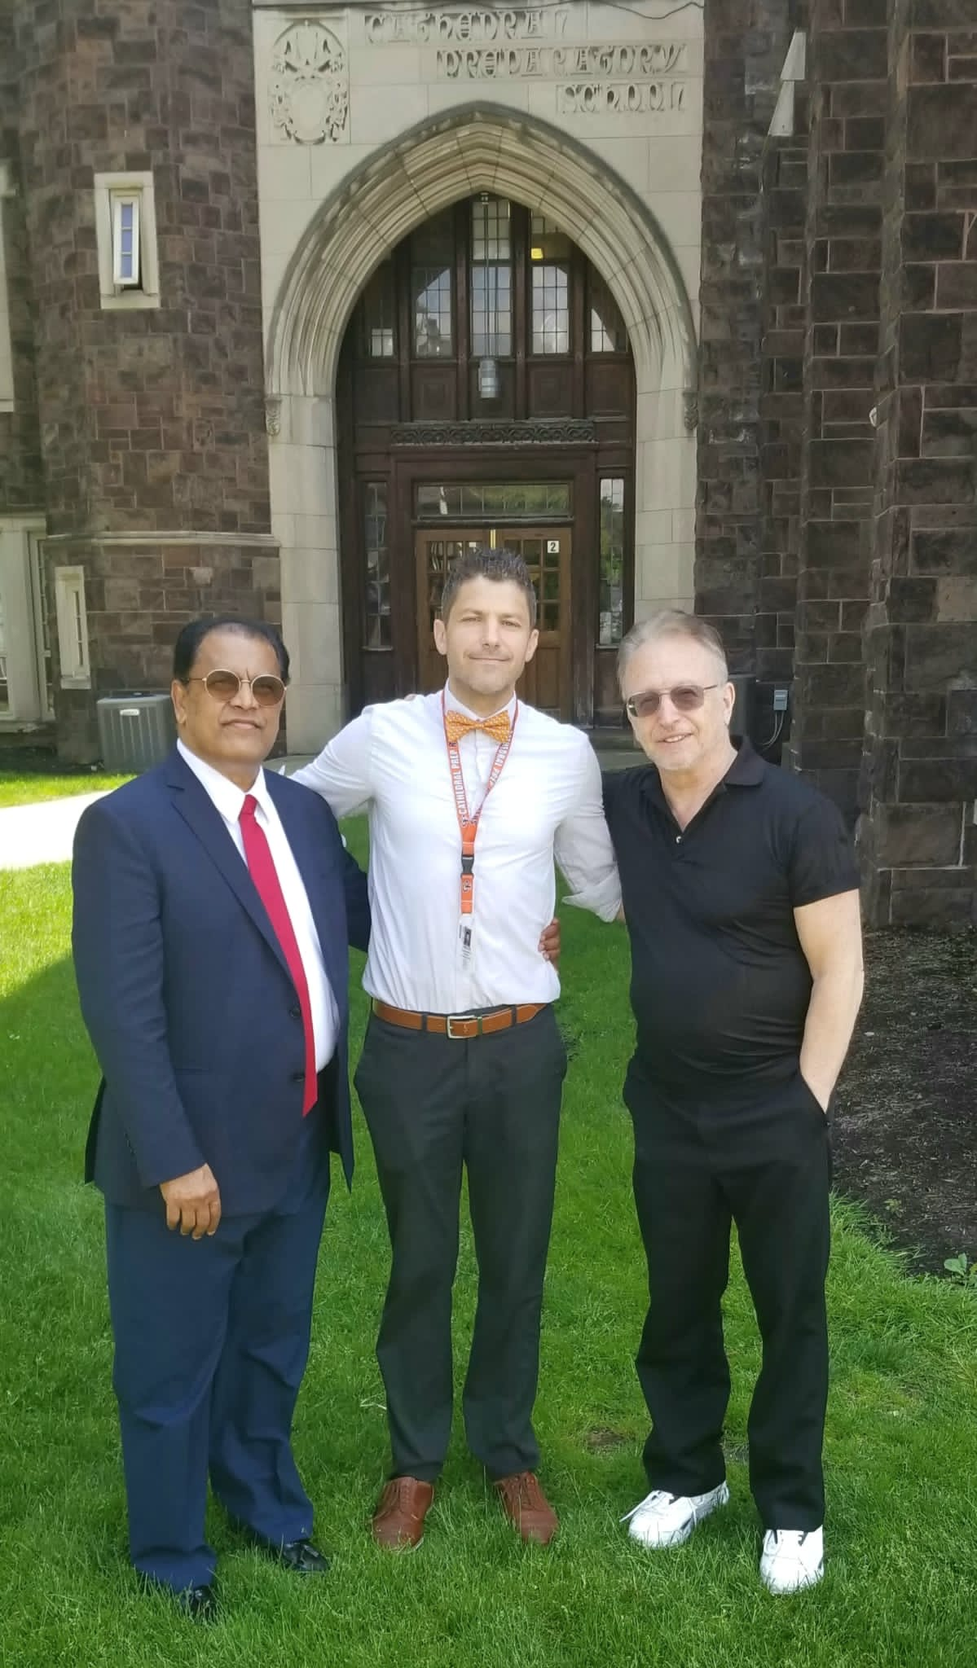
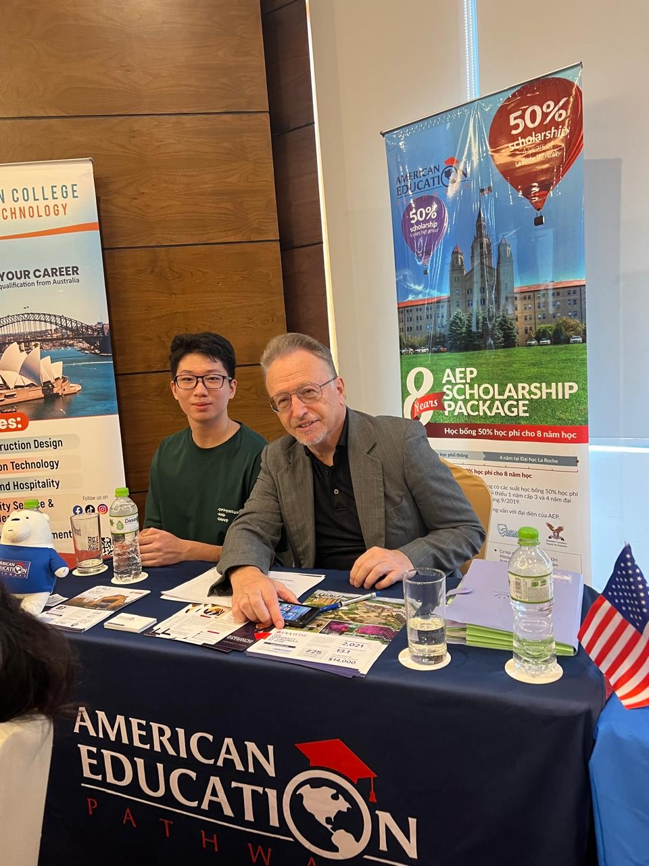
Connecting Asia and The U.S.A.

Slide 4
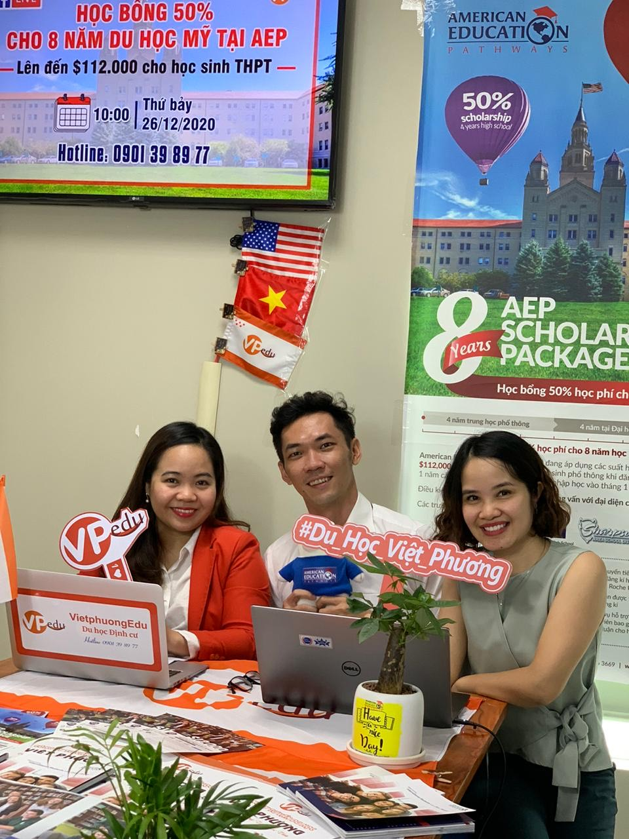
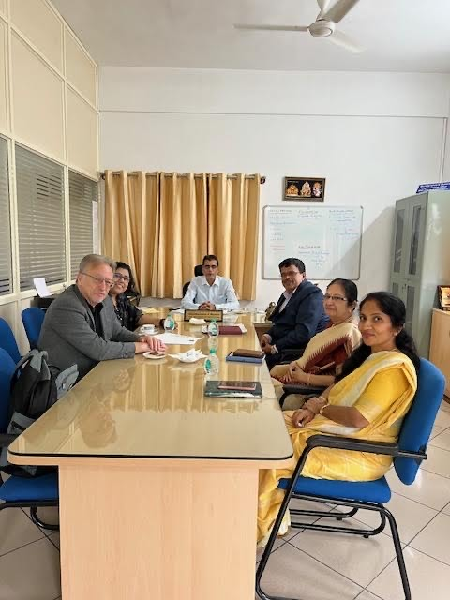
Education Fair (Vietnam)
School Officials in India

Slide 5
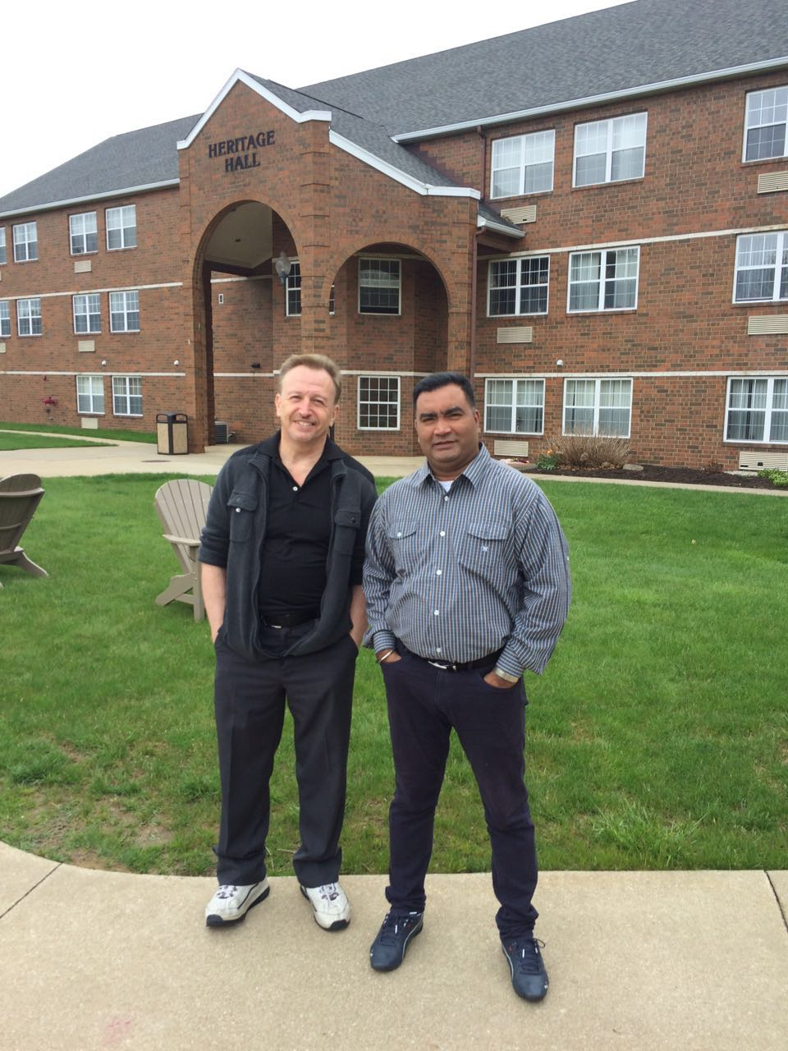
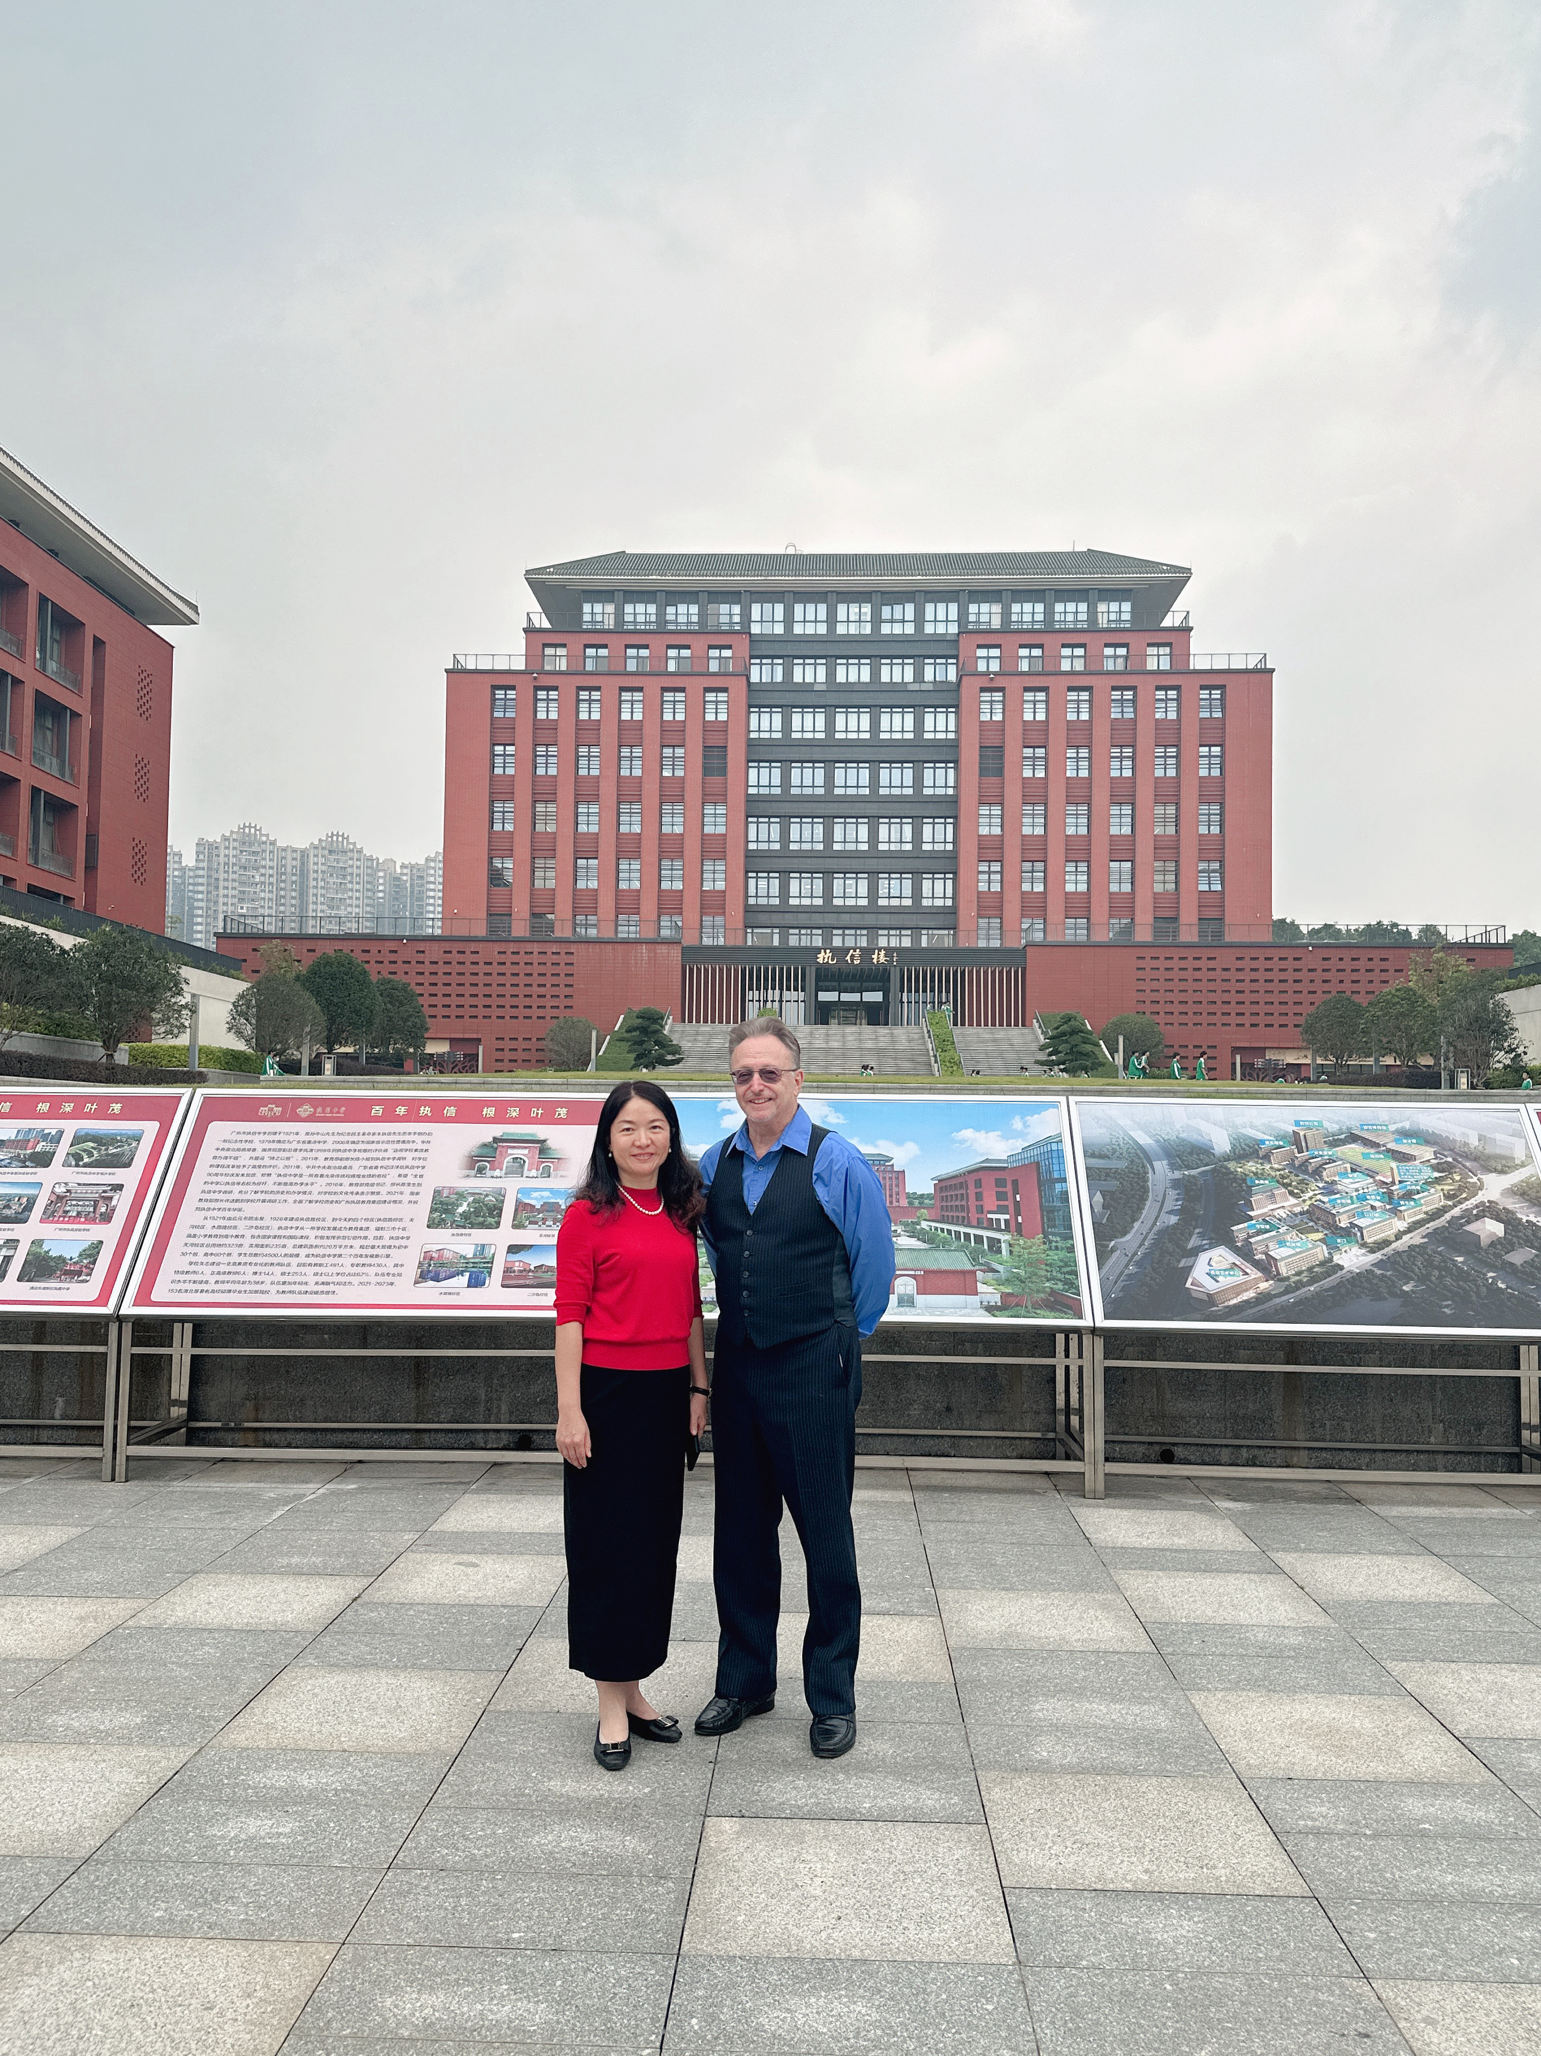
Vice-Principal, Guangzhou China
Indian Teacher at Westminster College, PA

Slide 6
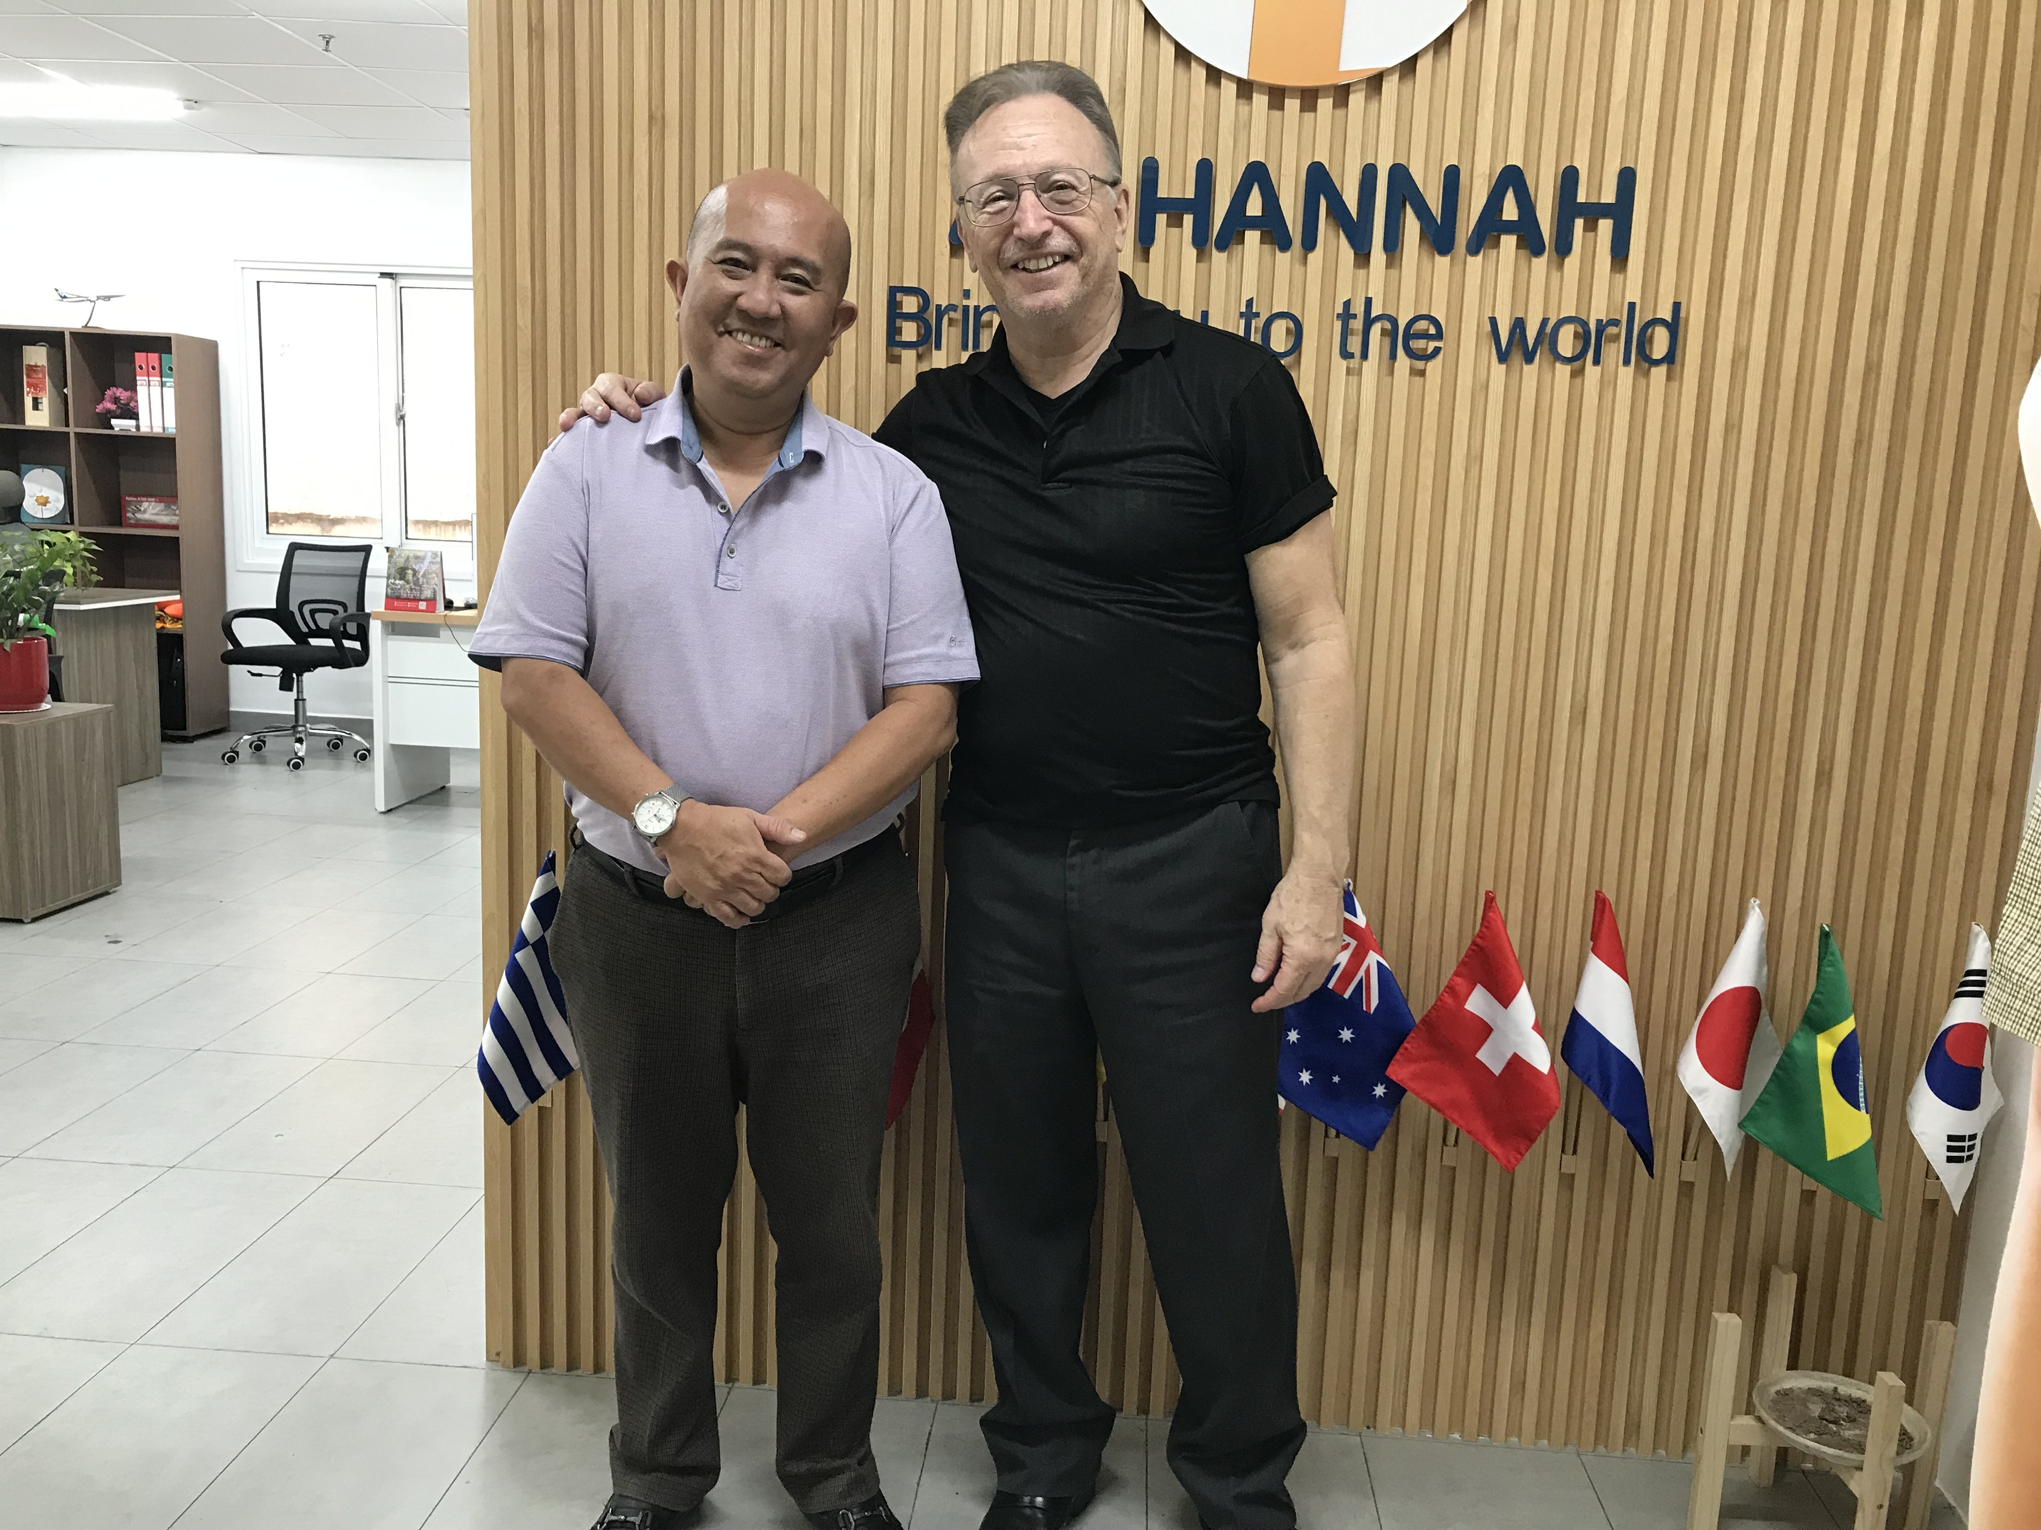
Bangkok Thailand with Agent

Slide 7
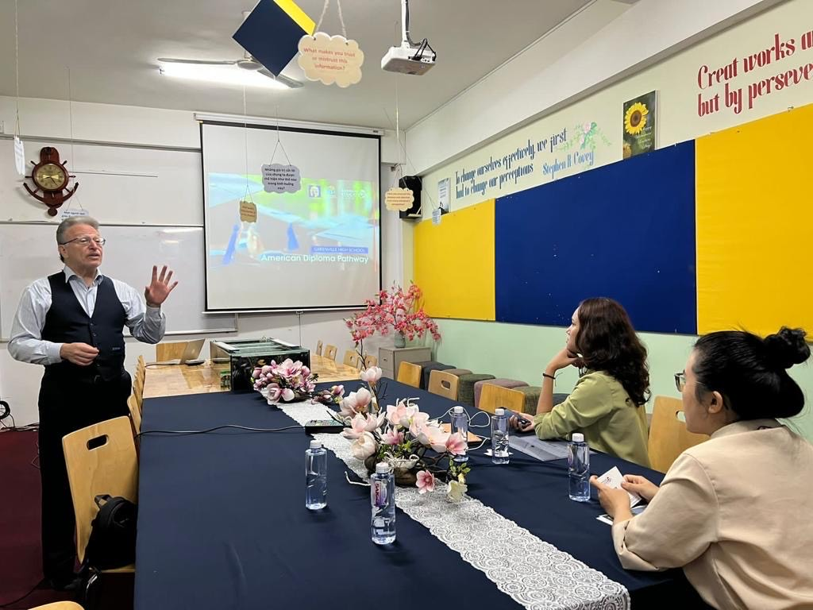
Introducting Greenville to School Officials in Ho Chi Minh, Vietnam

Slide 8
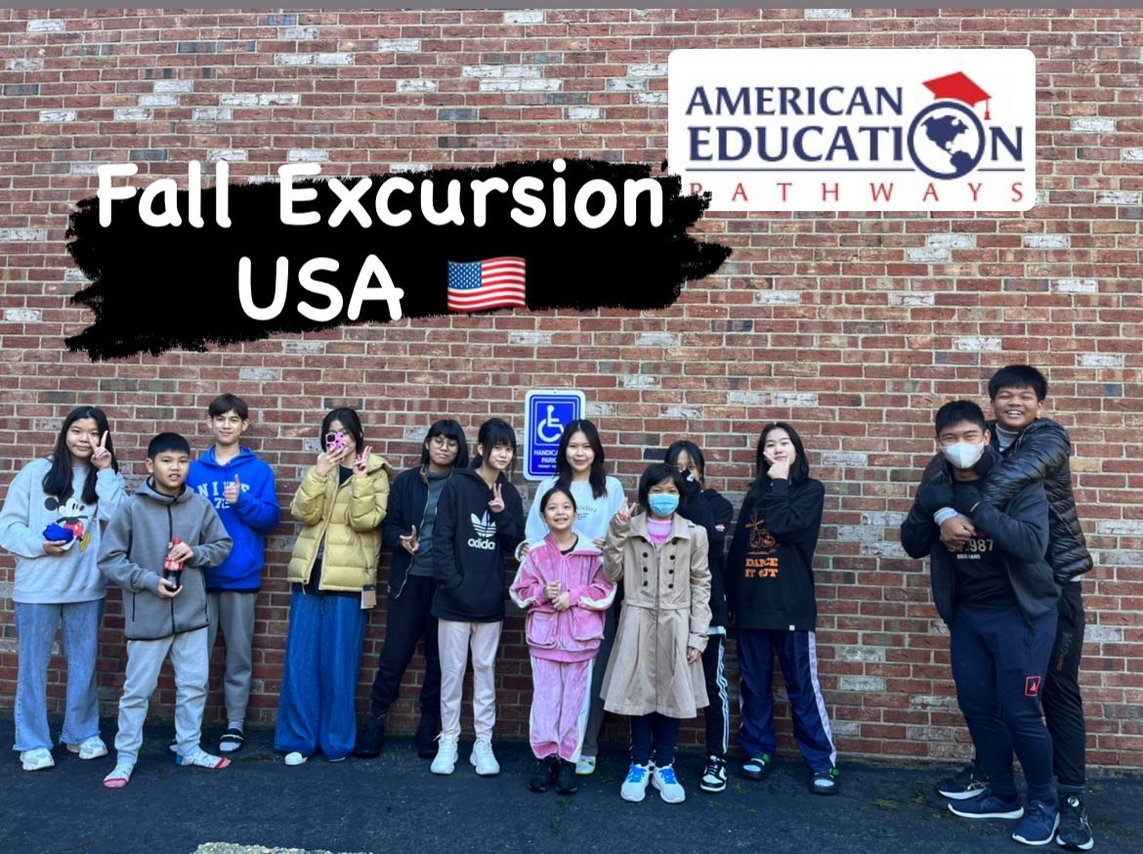
Thai Students Touring the USA

Slide 9
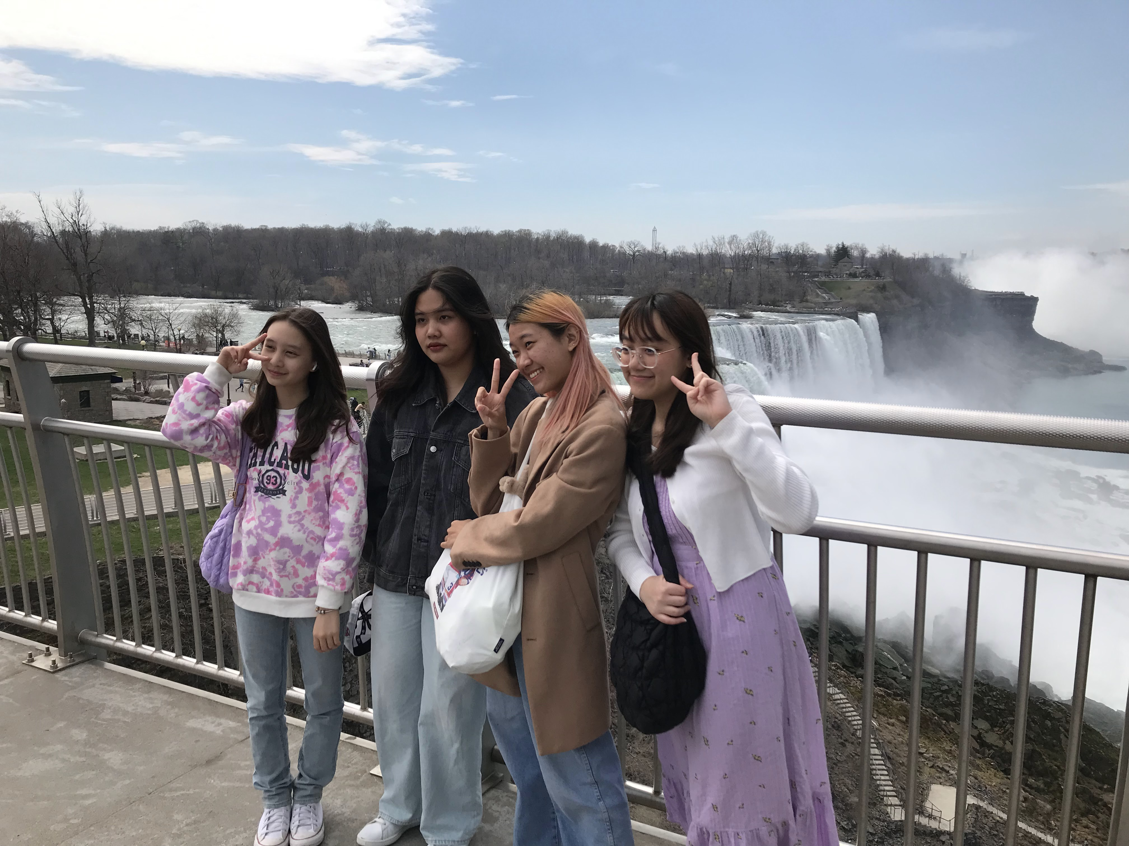
School Group at Niagara Falls

Slide 10
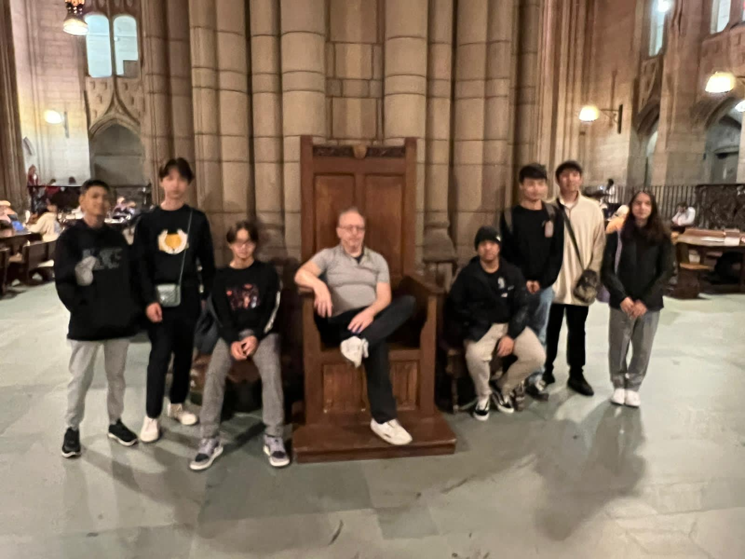
University of Pittsburgh
Cathedral of Learning

Slide 11

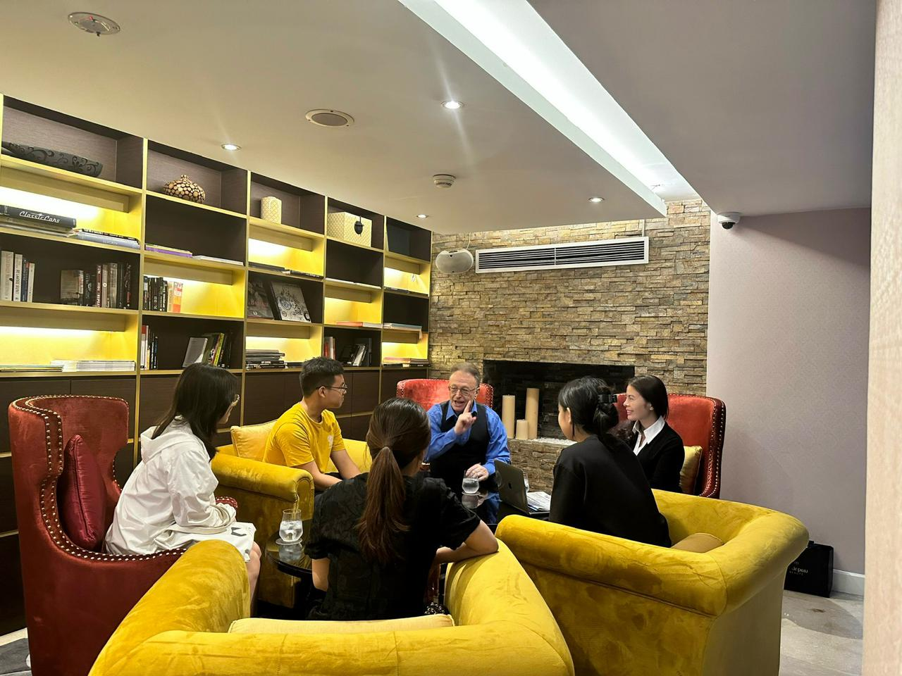
Radio Interview In Mumbai
Advising Students in Hanoi

Slide 12
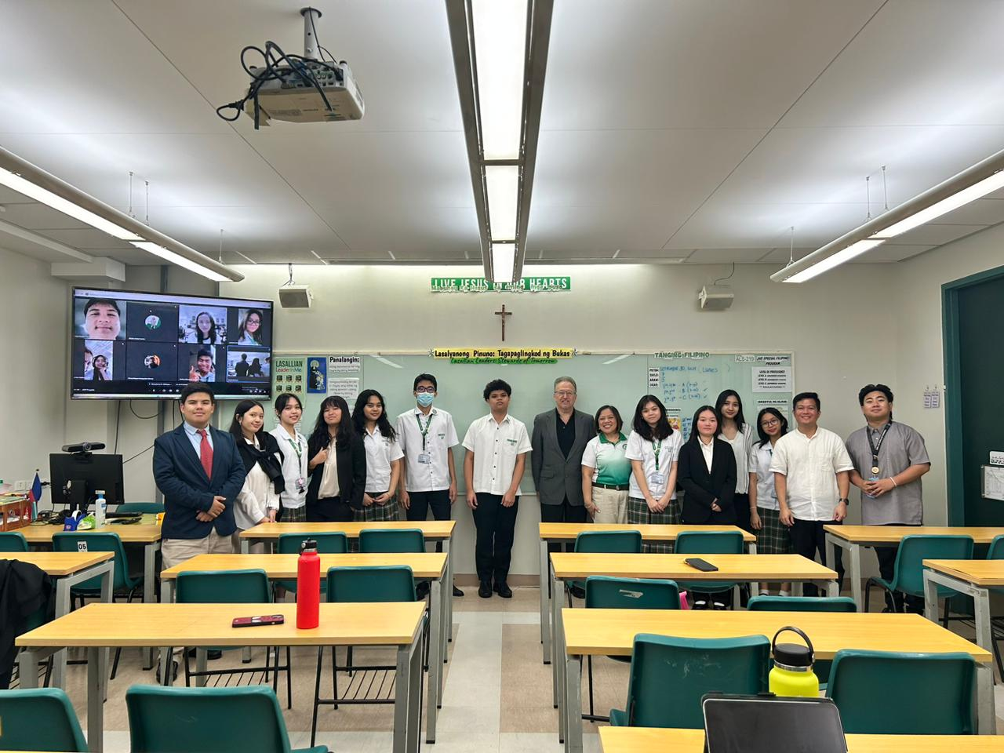
First Class of Diploma Pathways Students
Manila, Philippines

