Slide 1

Effective Approaches to Language Acquisition
Mastering American English as a Second Language

Slide 2

Test Your Knowledge
1. Which language has the most words?
A. Chinese
B. English
C. Spanish
D. Sanskrit

Slide 3

How many words does the English language have?
a. 6,000
b. 60,000
c. 160,000
d. 600,000
How many words does the average speaker of English know?
a. 6,000
b.60,000
c. 160,000
d. 600,000
How many words does the average English teacher know?
a.15,000
b. 50,000
c. 150,000
d. 500,000

Slide 4

How many languages are there in the world?
a. 1,000
b. 2,000
c. 5,000
d. 10,000
How many of these languages have a writing system?
a. 100
b. 1,000
c. 4,000
d. 9,000
What language has the most speakers?
What country has the most speakers of English?
True or False?
80% of all information stored on computer in the world is in English.

Slide 5




What language is most used in aviation?
What language is most used in diplomacy?
In what language are most scientific journals published in?
Why has English become the world’s international language?

Slide 6

The English language is 1,500 years old and is broken into three periods
Old English
Middle English
Modern English
William Shakespeare is considered the greatest writer in English history. Which period does he belong to?

Slide 7
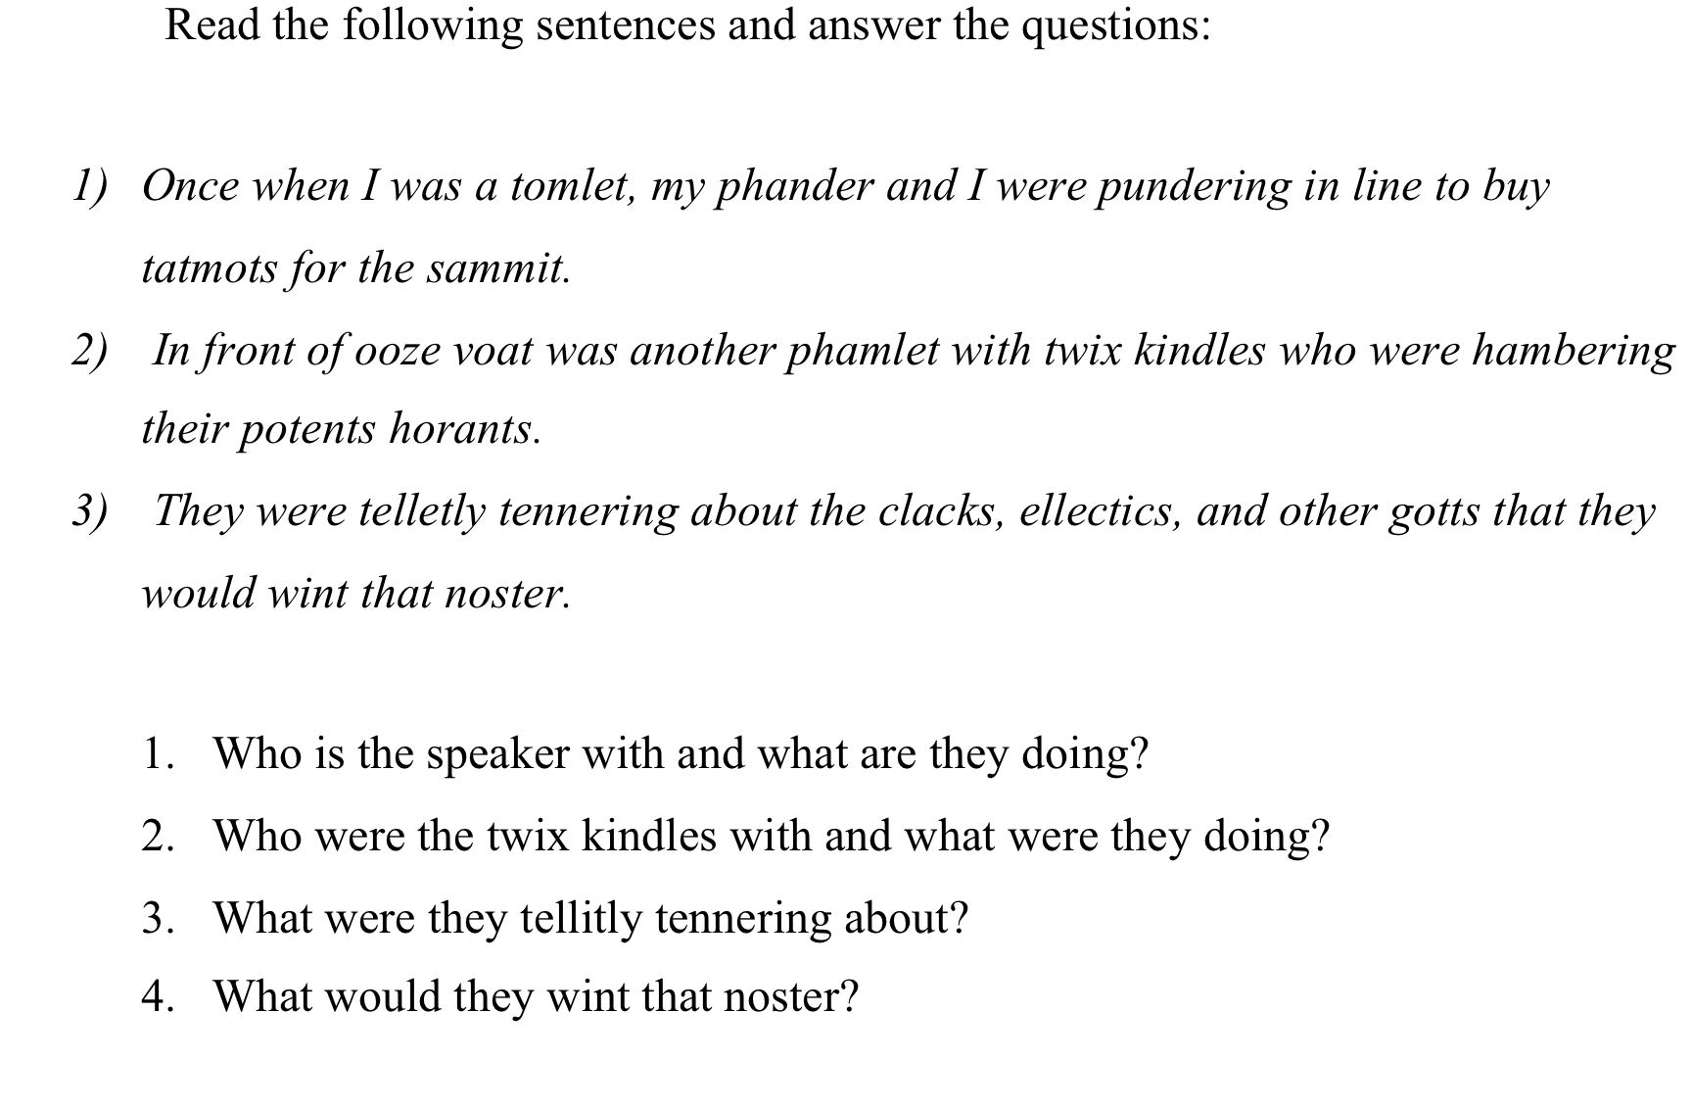

Slide 8
Read the following words- passed and past?
Explain the difference between the two.
Read the following words stared and starred?
Explain what they mean.
Read the phrases tie a bow and take a bow?
Explain what they mean.
Read the phrases close the door and move close to me?
How is c-l-o-s-e pronounced differently?

Slide 9
Mastering English requires the ability to distinguish between similar terms
Passed and past sound the same, but are quite different in meaning and function.
One is a verb denoting action that has already occurred. The other a noun that describes a point in time.
Stared and starred are both verbs but despite the similar spelling are pronounced very differently.
One means to look intensely at, the other to have the the main role in a movie or play.
Tie a bow and take a bow have similar sentence structures (verb + direct object).
Bow and bow, despite having the exact same spelling are pronounced differently.
The same applies to close and close, although the difference in pronunciation is more subtle.
Close is a verb meaning to shut. Close is an adjective meaning near.
Native speakers automatically know the differences. ESL learners will struggle.
Knowing the differences requires different types of linguistic awareness that will be explained later in the seminar.

Slide 10




English Language Learning
Instructional Objectives
Learning Objectives for English Language Learners (ELL)
Acculturation
(ESL vs. EFL)
Language Proficiency
(Oral vs. Written)
Motivation and autonomous learning
Meta-cognitive and meta-linguistic understanding

Slide 11
English Language Learning
English as a Second Language (ESL)
Student lives in a predominantly English speaking country
English is primary language of communication
English as a Foreign Language (EFL)
Student lives in a country where English is not the primary mode of communication
English for business or travel
Culture takes on a greater importance
Culture takes on a less significant role
Demands are less stringent
Requires a deeper broader understanding
(Idioms, Colloquialism, Connotations, Slang, Dialect)
(Standard English may be enough)

Slide 12


Language and Culture are intertwined (ESL)
Language is culture.
They can not be separated
Lack of cultural understanding leads to disorientation and confusion
Actions are interpreted through culture
(same action can be seen positively or negatively depending on culture)
Native speakers converse according to rules of the dominant culture
How is a conversation between a boss and employee different in Japan vs. the US?
Even when speaking the same language, lack of cultural understanding leads to miscommunication
Cultural differences are an obstacle to learning (different cultures value different skills)

Slide 13
American English: Culture in Language
Can you lend me a few bucks ? I’m short.
The defense doesn’t blitz enough or create turnovers and the quarterback gets sacked too often.
I can get into Country-Western or Rhythm & Blues, but I prefer Classic Rock.
They say Fox News leans to the right, but MSNBC is definitely left wing.

Slide 14

Understanding Language Acquisition
Why is this important ?
1. To develop effective classroom instruction, we need to understand how the brain operates.
2. If we don’t know why strategies work, we may give up on them prematurely.
3. To make informed judgments. Not all textbooks are effective. Teachers need to find the best classroom materials
What do ESL/EFL teachers need to know ?
1. Conversational fluency can develop rather quickly.
2. Academic proficiency; however, is more mentally challenging.
3. Beginning focus should be conversational. As proficiency advances, more academic content is added.
4. Conversational fluency often tricks teachers into thinking students are ready for academic challenges.

Slide 15
Effective Language Learning
Natural Language Learning (Brain Friendly)
Connect new words to sensory experiences
Decoding: what words function together in sentences as a single unit of thought
Use first language as bridge to learn second language
Supply Comprehension support (body language)
Learning language in the correct order
Focus on Vocabulary (meaning over function)
Background Knowledge: Connect new information with old
Using language in real world situations: Modeling and group interaction

Slide 16

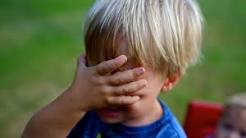
Traditional Methods Are Ineffective
So much of modern language instruction contradicts the brain’s natural learning requirements.
Students have taken English language courses for 5+ years and still can not speak English fluently.

Slide 17


Why Some Students Fail
Traditional methods use a “one size fits all” approach and ignores diversity of learning styles and intelligence preferences.
Some students lack natural language skills and must be taught the most effective techniques (meta-cognition).
Traditional language teaching methods run contrary to the brain’s natural information processing.

Slide 18
Why Traditional Methods Fail
An overreliance on rote memorization
An emphasis of structure and function over meaning

Slide 19


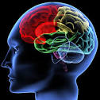
How We Learn
Short-term memory filters out important information from non-essential
If information is relevant for the moment it makes it to working memory
Brain decides if information has long term application: If not discarded. If yes, it goes into long-term memory

Slide 20
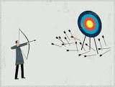

Why Rote Memorization Is Ineffective
Rote memorization is not brain friendly.
The brain must recognize the real world application of the learning to reach long-term memory.
Rote memorization only activates working memory and is devoid of meaning.
Working memory is temporary. Information discarded when no longer needed.

Slide 21



True Learning
Long-term memory
Information is comprehensible and meaningful
Long-term memory
Information connects to and enhances previously learned knowledge
Long-term memory
The brain recognizes real world application and future benefits of new information

Slide 22
Real World Application
Make the language come alive
The brain will retain information that has
long-term value
The student needs to connect the new word with his daily life.
1. The results of my English and Math exams were a calamity, two “D”s. My parents will be so angry.
2. Losing the English competition was a calamity. I was depressed for a week.
Justin Bieber’s image is ubiquitous; I turn on the TV, he’s there. I turn on the radio; his song is playing. His picture is on every magazine. There’s even a poster of him hanging in the girl’s locker room.

Slide 23

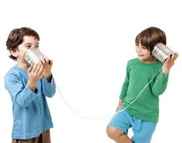
Function vs. Meaning
Language comprehension is all about communicating meaning.
Therefore, more time should be spent on teaching semantics rather than on function.
The brain is constantly seeking meaning in linguistic communications.
Grammar should be taught by modeling. Model learning is highly brain-friendly.

Slide 24
Chomsky’s Challenge
Anyone with an intermediate knowledge of English can easily define these five words. But string them together as a unit and there’s confusion
Furiously sleep ideas green colorless
The next sentence presents a different problem. It sounds correct, but what does it mean? Even a grammatically correct sentence is useless if it lacks meaning.
Colorless green ideas sleep furiously

Slide 25
Chomsky’s Challenge
The final sentence is easy to understand. We can all comprehend its meaning, but it’s grammatically incorrect.
Sleeping seems the child.
1. The first grouping of words is clearly not a sentence despite containing five perfectly good English words. 2. The second sentence is grammatically valid but makes no sense. 3.The third breaks all the rules of grammar but communicates meaning.
Many non-native speakers make mistakes similar to the third sentence.

Slide 26
Chomsky’s Challenge: Relevancy to ESL
The purpose of language is communication.
If we fail to understand the intended idea, then the language used is ineffective.
Chomsky has demonstrated that even with perfect grammar and syntax, communication is not achieved without semantics.
Chomsky has also demonstrated that even when grammar and syntax are improperly used, communicating meaning is still possible.
Conclusion- Conveying meaning is the priority and should be the focus of all second language instruction. Without it, nothing else matters.

Slide 27

Brain Friendly Learning
The human brain is hardwired to learn language in a certain way
By appealing to the brain’s natural tendencies, learning becomes faster and easier
Natural Language Learning

Slide 28
Linguistic Domains and Natural Language Development
Writing
Reading
Speaking
Listening

Slide 29
Differences Between Oral and Written Language
Traditional language instruction fails to recognize differences between oral and written language.
There are four abilities related to language.
Two involve oral language: Listening and Speaking.
Two involve written language: Reading and Writing.
Two of these abilities are passive in that information is received: Listening and Reading.
Two of these abilities are active and require an act of creation. Speaking and Writing.
Natural language learning follows a preset order that does not change with age.
It’s easier to receive information than create it.
The ability to comprehend spoken language will always come before the ability to speak it.
The ability to read will always precede the ability to write.
This process doesn’t work well in reverse.
It makes more sense to use nature to our advantage than working against the way the brain was hardwired.

Slide 30
Natural Language Learning
Listening and Speaking
The ability to comprehend oral language will always come before the ability to speak it.
Reading and Writing
In school, we master reading long before we master writing.
Writing is always the last and most difficult skill to acquire. Everyone speaks on a daily basis, but not everyone writes.
As children, we could understand our parents long before we could express our thoughts.

Slide 31
Oral Language versus Written Language
While oral proficiency can develop in multiple languages simultaneously, literacy cannot.
Literacy training must be complete in L1 before it can take hold in L2.
Difficult to take L2 students beyond level achieved in L1

Slide 32
Oral and written language require two different skill sets
They activate two entirely different parts of the brain.
Oral expression is our first experience with language and is the foundation on which all linguistic skills are built.
What Are The Major Differences
Written requires formal schooling.
Oral is learned naturally by observation and through modeling.
(AEP offers a class on oral presentation)

Slide 33

Improving Oral Comprehension
Learning language involves combining images and symbols
Language is a social phenomenon. Interaction enhances oral development
Vocabulary learning is more effective when presented for group discussion
Interacting with peers plants new words in growing minds
A second language is learned best through meaningful communication
Oral interaction builds knowledge and stimulates creative thought

Slide 34
Using Oral Language to Enhance Vocabulary
Natural vocabulary acquisition begins early in the home.
Vocabulary is acquired through modeling.
After schooling begins, reading becomes our main source of new vocabulary.
But if we can’t pronounce a word, chances are we won’t remember it.
In order to use a word, even in writing, we must be able to say it.

Slide 35



Oral Language Learning Requires Comprehension Support
Total language immersion is ineffective if it lacks comprehension support
Early language learning connects sensory experience with sound. Sensory input with language learning offers comprehension support
Using first language background knowledge in second language learning offers comprehension support

Slide 36
Interaction and Modeling (Natural Language Learning)
Challenge: Even students from same linguistic background have varying degrees of proficiency
Solution: Pair up good students with lesser students:
1. Better students model correct language for lesser students
2. Teaching reinforces information for better students

Slide 37


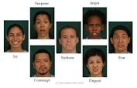

Classroom Activities That Work
Comprehension support, context, prior knowledge.
Effective language acquisition requires sensory input.
Sensory input connected with sound symbols.
Pictures, objects, and body language give visual clues and context.
Apply knowledge and skills the student already possesses.

Slide 38
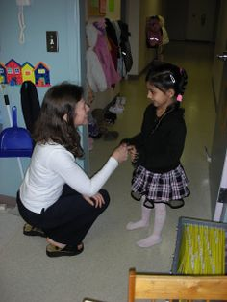
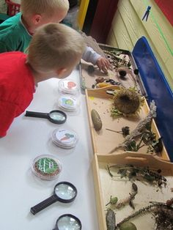
Social Learning Theory (Modeling Behavior)
Human brain is hardwired to learn from interacting with others. Remains effective through out our lives
More skilled members model behavior for those less skilled in the behavior
As young children, we learned by observing behaviors of parents and older siblings

Slide 39
Comprehension Support
Oral language is a social phenomenon
Interacting with others supports word meaning.
Our environment provides context which supports word meaning.
Providing context, stimulating the senses, , and using authentic communication
Interaction includes gestures, facial expressions, and intonations.
Comprehension support is missing in written language.

Slide 40
Oral Interaction Works
Students are learning concepts (ideas) not definitions.
Pair beginning students with intermediate ones: the intermediate students with advanced.
Teaching lesser students reinforces stronger students knowledge.
Collaborative dialogue with stronger peers models language for weaker students.

Slide 41
Language Learning Myth
Myth: mixing language interferes with learning process
Myth: never allow students to use their native language when learning a second language
Mixing old knowledge with new knowledge makes it easier to assimilate
Code mixing (combining L1 and L2) does not interfere with learning L2. It in fact facilitates its integration by connecting new learning with old.
1. In beginning, language mixture 80/20 L1/L2
2. As mastery increases. Gradually replace L1 words with L2
3. Towards end, lessons become 20/80 L1/L2
Using first language offers comprehension support
As new vocabulary knowledge grows, gradually replace old language with new language vocabulary

Slide 42


Domain Interaction
Oral and written language independents skills
They activate two separate parts of the brain.
Many courses address each skill as distinct subjects.
However, each skill should be addressed simultaneously.
Never-the-less, the brain does co-ordinate between the four skills.
Each domain supports the other, facilitating long-term retention.

Slide 43



A Comprehensive Linguistic Approach
Offers listening, speaking, reading, and writing instruction concurrently
Each domain reinforces the others, cementing learning into long-term memory
Audio, visual, tactile, & kinesthetic
learning is activated

Slide 44
Using Multiple Modalities
By combining multiple learning modalities, learning is strengthened.
Reading + Speaking (readers often read out loud to themselves)
Visual + Listening (our first experience as children)
Kinesthetic + Listening + Visual (combining three)
Visual + Reading (picture books)
All of these create a deeper learning experience that solidifies the information into long-term memory.

Slide 45
Domain Relationship
Listening is the first skill developed and the foundation of all further language skills. Beginning instruction should have heavy emphasis on listening.
Example: (Level One) Listening 60%, Speaking 25%, Reading 10%, Writing 5%.
Focus gradually shifts as instruction becomes more complex.
Example: (Level Four) Reading & Writing 75%, Listening & Speaking 25%.
Even at advanced levels, connecting language with sound- sound with images is still an important part of learning and retaining words.

Slide 46
Using Prior Knowledge
Previously Acquired Information
Skills already mastered
Memorable past experiences
New layers of information on top of old layers
It’s easier to build onto something that already exists than to start from scratch

Slide 47
Background Knowledge
Vocabulary and Decoding skills are not enough
The ability to decipher a language is only half the battle.
Background knowledge on the subject matter is needed for comprehension
Textbook writers will assume student has pre-requisite background knowledge. ESL students start at a distinct disadvantage.
The vast majority of the U.S.population already knows the nuances of culture, politics, or geography.
Without this information, non-native speakers flounder in a sea of confusion.
Language is culture: Culture is language.

Slide 48
Background Knowledge
Native speakers carry a store of cultural, historical, geographical, and social knowledge into a conversation.
The speaker will assume the listener has this knowledge and will not take the time to explain the details.

Slide 49
Building Background Knowledge
Before reading an assignment in English, allow student to read in native language
Before reading an assignment in English, students must focus on any vocabulary words they are unfamiliar with
Before reading assignment in English, students should read simplified outline that summarizes key points

Slide 50


Bridging Knowledge
Proficiency requires setting expectations and making predictions.
By focusing on relevant details, previewing builds foundations upon which more complex learning is built
Allows for bridging, making connections to previous learning. Necessary when students lack background knowledge
There may be something in previous learning that shares similarities with the new information.
Connecting new information to old facilitates assimilation of the new

Slide 51


Link Between First Language and Second Language Proficiency
Research shows literacy is transferable from L1 to L2.
Images and associations connected to L1 words should be used to facilitate L2 assimilation.
The more proficient students are in L1, the easier it is to learn additional languages.

Slide 52
Preview: Building a Foundation
Formatively assess for background knowledge
Have students peruse text for unknown vocabulary
Provide outlines, summaries, illustrations, graphs (Visuals)
Allow students to research material using native language sources
Connect key concepts to student’s lives (Bridging)
Clear up misconceptions and gaps in knowledge

Slide 53


Review and Preview
Before a lesson is given in English, key words and ideas are introduced.
Lesson is given in English.
Key vocabulary and main ideas are reviewed, cementing information in students’ minds.
A film related to subject can be shown.
Background knowledge adds context and stimulates associations.
Text can be summarized. A copy of lesson can be delivered first in L1

Slide 54


Why Previewing Works
The brain is already searching for information that makes lesson comprehensible
By building expectations, we activate background knowledge
Previewing builds expectations

Slide 55
Creating Categories
Prior knowledge is a major factor in language comprehension. Previously acquired knowledge helps us make sense of the new.
All humans create categories of images that we file in long-term memory.
As we learn new information, we file it under an existing category.

Slide 56
Decoding Language
In order to decode language, a person receiving communication must know rules, structure, and basic vocabulary.
He must be familiar with with parts of speech, mechanics of speech and text, and grammar rules.
The average five year old has mastered the rules and structure in his native tongue.
His understanding of natural grammar will form the foundation of formal grammar training.
The need for decoding skills is the reason most foreign language courses emphasize grammar.
However, oral language and written language are separate skills.
Formal grammar is a product of writing and requires formal instruction.
Natural grammar as learned in speech is intuitive and is acquired through modeling.

Slide 57
Linguistic Awareness
Phonological
Orthographic
Syntactic
Semantic
Pragmatic

Slide 58

Phonological
The inability to pronounce a word hinders long-term retention
Phonemes: sounds that signal a shift in meaning in similar sounding words
Allophones: variations in sounds that do not signal semantic shifts (dialect)

Slide 59
Relevancy to ESL
A phoneme in English may be an allophone in another language.
In English “d” and “t” are distinct sounds when they appear at the beginning of the word (dot/tot), but not necessarily at the end (talked/crowded).
In some languages, there is no distinction between these sounds.
These differences are referred to as accent and can create errors in pronunciation and listening comprehension.

Slide 60
Teaching Pronunciation
Do not overcorrect. Overcorrecting will embarrass and discourage students from speaking.
If communication is successful, acknowledge understanding by repeating the information in correct form.
By modeling correct sounds and structures during social interaction, proficiency is developed.

Slide 61


Orthographic
Letter to sound correspondence in English is imperfect and inconsistent
(giant/grant/gnat).
Writing conventions do not correspond to speaking conventions (sign/signal).
Problem areas: homographs, consonant, and vowel shifts.
Recommendation: correct spelling errors but do not deduct points for them. Most Americans struggle with spelling. Mastery takes time and practice

Slide 62
Syntactical Awareness
English is heavily dependent of syntax
Word order signals function and relationship between words.
Word knowledge alone is insufficient to convey meaning.
Every sentence has “word strings” or groups of words that act as independent units of thought and meaning.
The ability to recognize groupings within sentences is essential for comprehension

Slide 63



Syntactical Awareness
Heavy- drifted- a-sky-the-Jack rain-glanced while- lightning across illuminated outside- the night-room cloud As.
Heavy rain clouds
The night sky
Illuminated the room
Glanced outside
A heavy rain cloud drifted
Across the night sky
Drifted across
While lightning
Jack glanced outside
While lightning
Illuminated the room
Without syntactical awareness, a sentence is a string of words devoid of context
Certain words group together
Like pieces of a puzzle, meaning becomes clear

Slide 64
Relevancy to ESL
Problem area: without syntactical awareness, a sentence is a string of words devoid of context.
Recommendation: Break sentence into constituent parts. Teach pronunciation and meaning of these “word strings” just as you would a vocabulary word.
Once these words strings are mastered, reconstruct sentence.
Many experts believe that learning how to “segment” sentence constructions is the key to achieving native-like proficiency.

Slide 65
Semantic Awareness
Vocabulary knowledge is the number one factor in comprehension.
Vocabulary is best learned in context and in real world situations.
Rote memorization of dictionary definitions is NOT true learning and is an ineffective way to build vocabulary.
Assimilating new words requires multiple exposures in varied contexts over time.

Slide 66
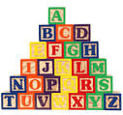
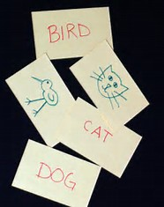
Semantics: Building Meaning
Word associations and mental pictures supply depth and breadth of knowledge.
Connecting new words with sensory experiences cements the word in long-term memory.
Vocabulary learning requires comprehension support.

Slide 67




Word Associations
Beach
ocean
waves
sand
seagulls
sun bathers

Slide 68
Connecting words with images and sensory experience
SOUND
* Hear the waves crashing against the surf
* Hear seagulls cawing
Feeling
* Feeling the warm sun on your face
*Feeling the ocean breeze blowing against your body
*Feeling the hot sand on your feet
Smell
* Smell the suntan lotion that people are wearing
* Smell the salty ocean air

Slide 69


Building meaning: Depth and Breadth of Understanding
Knowing a word
The more words filed together in long-term memory,
The deeper and broader our understanding

Slide 70
Types of Meaning
Concrete vs. Abstract
House
Security
Literal vs. Figurative
A flimsy nightgown
A flimsy excuse
Denotative vs. Connotative
Smart
Sly

Slide 71
Relevancy to ESL
Recommendation: Have students build word associations through mental images rather than memorize definitions.
Word webs mimic the brain’s natural tendency to build neural networks of association.
Recommendation: allow students to use native language. Research shows linguistic knowledge (images) gained through L1 is transferable to L2.
Use visuals ( illustrations, images, graphs, videos) to reinforce meaning.

Slide 72
Relevancy to ESL
Problem area: A student can have phonological and syntactic awareness but still lack a semantic foundation.
This can fool teachers into thinking the students are comprehending when in fact they are not.
Recommendation: Formatively assess for comprehension on a regular basis.
Problem area: Collocations are two or more words that normally occur together. For example, a native speaker would use the term “powerful” computer not “strong” computer. However, in certain phrases strong and powerful are interchangeable (strong wind vs. powerful wind).

Slide 73
Relevancy to ESL
Problem area: Idioms are expressions that carry meaning that can’t always be discerned by the words or structure.
Native speakers use them frequently as they convey a great deal of information in a concise manner.
Unfortunately, there are no hard, fast rules for learning collocations or idioms.
Recommendation: Have students keep a word journal that include these linguistic expressions as well as new vocabulary.
Explanation of meaning should be simple, possibly even in native language.
Included are sample sentences using the word in context. If possible, sentences should include real world situations that relate to student’s real life experiences.

Slide 74



PRAGMATICS
Accurate language choices in appropriate social setting
Register: an awareness of setting
Role and relationship of listener and speaker
Formal vs. informal
Standard vs. non-standard

Slide 75
Relevancy to ESL
Problem area: Linguistic pragmatics vary from culture to culture.
A lack of pragmatic understanding is often mistaken for rudeness.
Recommendation: Be aware that pragmatic usage varies greatly from culture to culture.
Do not assume background knowledge of language etiquette.
Pragmatic skills take time to develop and must be consciously taught and targeted. Social interaction with native speakers models English pragmatics.

Slide 76
Decoding English: Challenges and Solutions
Problem area: No matter how proficient one’s decoding skills are, a lack of background knowledge of the topic will impede communication.
Problem area: Phonological, syntactic, and even semantic fluency can fool teachers in to thinking that students are comprehending.
Recommendation: Do not assume anything! Teachers must constantly assess for comprehension.
Recommendation: Build linguistic or subject area background knowledge before the lesson begins.
Recommendation: Find connections between students prior experience or skills and the new knowledge/skills to be mastered.

Slide 77
Words as Symbols
Sound Symbols
All humans share similar concepts: trees, birds, children.
Say a word in our mother tongue and a picture appears in our heads.
Written Symbols
In school, we learn written symbols can represent the sound symbols that represent the pictures in our brains.
In school, we are first introduced to formal grammar.
Children learn to connect sounds to things they see or feel.
Sensual experiences create images in our brains. When sounds occur often enough in connection with experiences, the sound alone will evoke the images without the object being present.
Reading replaces oral language as the primary source of vocabulary acquisition.

Slide 78



Connecting Symbols and Common Meaning
Spoken words are just symbols for ideas
Written words are symbols for spoken words
Everyone must agree on the symbols or there is no communication
We call this sharing of symbols common meaning
Because people who speak different languages disagree on the symbols, they can’t communicate

Slide 79

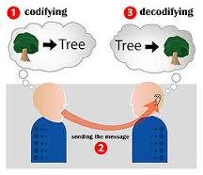
Words are Magic
When two speakers share symbols something magical happens
An image born in someone’s brain can travel across space and time
And be planted in the brain of another

Slide 80

Vocabulary Building
Basic Vocabulary
(Tier One)
Proficiency in basic words is essential.
These are the first words learned in in the language acquisition process.
Basic words are the foundation of oral communication and are reinforced in daily speech

Slide 81
Basic Vocabulary
Most foreign language classes do a good job of teaching tier one vocabulary.
However, proficiency in tier one will not get a language learner beyond the intermediate stage.
In order to get beyond the intermediate level, a student must master a significant amount of tier two words.

Slide 82


Tier Two Vocabulary
Tier Two
Encountered frequently in speech and writing
Can be used in a wide range of activities
Signals a mature language user and demonstrates language fluency

Slide 83
Tier Two Vocabulary
Is needed to get beyond the intermediate level.
Examples of tier two words are facilitate, analyze, and absurd.
English instruction should emphasize tier two.

Slide 84


Tier Three
Are specialized words, rarely encountered, found in specific professions or activities
Sample tier three vocabulary could be photosynthesis or quantum mechanics
Since they are seldom used outside their specialty field, language teachers can ignore these words

Slide 85




Vocabulary is #1
English
German
T1
French
T1 -2
Latin
T2 -3
Borrowed Words

Slide 86
English Vocabulary
English has at least three ways to say the exact same thing: tired (German), fatigued (French), exhausted (Latin).
At its heart, English is a Germanic language. A vast majority of the spoken words are German based ( Tier 1).
English grammar however is based on Latin, not the best fit.
This explains the inconsistencies found in English grammar.

Slide 87
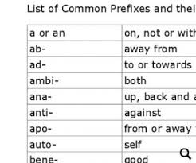
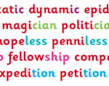
Segmenting Words
Difficult tier two vocabulary can be segmented and more easily pronounced.
At first glance, some multi-syllable words can be daunting.
Synonymous
Hibernate
Compromise

Slide 88

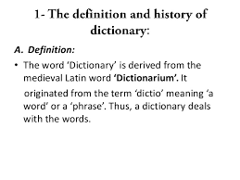

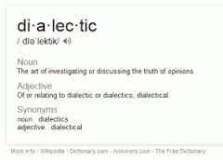
Dictionary Definitions
Learning a word’s definition is not the same as knowing a word.
Dictionary definitions create no mental pictures and lack “real world “ application.
No one has ever learned how to use a word by studying a dictionary definition.

Slide 89
Classifying Vocabulary
Which of the following words are tier one , two, or three?
Sleeping proponent soliloquy remedial mishap sister malcontent bread protozoan pretzel epidermal orthography irrevocable water sporadic angel
Demented master pedagogue litigants simultaneous honey house monopolize kleptomania bureaucracy diathermy abundance onomatopoeia singing pyrotechnic

Slide 90
Knowing a Word
What does it mean to know a word?
There are qualitatively different kinds of word knowledge.
Word knowledge falls within a range.
Level One
You come across a word for the first time.
You have no knowledge of its meaning but you know it exists.
Level Two
You’ve seen the word before and can classify the “part of speech” it belongs to.
You’ve looked it up before, but can’t recall its meaning.

Slide 91
Knowing a Word
Level Three
You have a general sense of the words meaning, whether it’s positive or negative.
You lack breadth and depth of understanding.
Level Four
You can define the word and understand the word in context along with its multiple meanings.
You never use the word in speech or writing.
Level Five
You understand a word’s literal and figurative uses. You have breadth and depth of knowledge.
It’s part of your personal lexicon. You “own” the word.

Slide 92
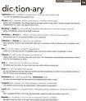
How to Learn English Vocabulary
Looking up words in a dictionary does not work!
Translating and memorizing words is ineffective!
None of these methods have “real word” application!

Slide 93


What Does Work?
Visualization
Associations

Slide 94
The Best Way to Learn New Vocabulary
Visualization
Creates mental pictures that go with a sound symbol
Mimics language learning we used as small children
Associations
Provide multiple images connected to background knowledge
Using old information to connect with new information facilitates learning

Slide 95
The Power of Associations
Once a student learns how to pronounce a word and is given a student friendly definition, the next step is to add associations.
Associations are not definitions but connections.
Every word in our lexicon is connected to other words, images, and pictures.
The more associations we have with a word, the deeper our knowledge.

Slide 96
Classroom Activities
Should mimic real life experiences to make language learning relevant to students’ lives
Activities should model natural language
Should focus on vocabulary and pronunciation
Reading lacks environmental supports
Images and associations give words meaning
When we see a word for the first time, how can our brain create an image without comprehension support? No picture…no meaning.

Slide 97
How it Works
We must be able to exercise and express ourselves in a language or we will not use it!
Creating visuals works for both spoken and written words.
However, language acquisition works best if we first learn the word orally.
We were born to speak. We were not born to write.
Pronouncing the new word while creating an image in your mind causes a connection.

Slide 98
Teaching English Vocabulary
The first step is to introduce new words to the class.
Pronounce the word and have them repeat it multiple times.
Speech is natural and oral skills are the foundation of
Language.
Introduce a student friendly definition NOT a dictionary one.
Student friendly means easy to understand and can be related to prior knowledge.
It’s okay to give it in Thai. Native words have mental pictures associated with them. Use prior knowledge.
Unknown words have no mental images. Words we know have multiple ones.
By connecting old words with new words, we are transferring the images.
Dictionary definitions create no mental picture!

Slide 99

Graphic Organizer: Creating Images through Associations
U-bi-qui-tous
* People
* Germs
* Air
* Dirt
* Water
* Plants

Slide 100

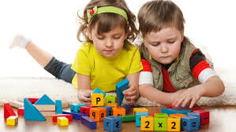

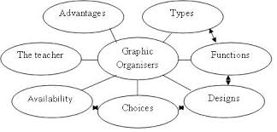
Mental Pictures Reinforce Word Meaning
It‘s human nature to look for connections in things.
Association is learning vocabulary the natural way.
This is how small children learn language
Graphic organizers are a great way to visualize and catalog associations

Slide 101
Associations Work
Beach
Sand, waves, ocean
Aviation
Planes, blimps, landing strips,
Calamity
Tsunami, car accident, earthquake
Famine, stock market crash
breeze, bathing suits, sun
wings, hangars

Slide 102

Multiple Context
The country suffered many disasters such as Tsunami, earthquakes, and famine.
Disaster
The results of his final exams were disastrous, two “c”s and two “d”s
After a disastrous marriage, the husband and wife got a divorce.
The stock market crash was a disaster for the economy

Slide 103
Multiple Context
After a word’s been introduced, the teacher needs to keep coming back to it over the ensuing weeks and months.
Multiple encounters are required before the student “owns” the word.
Multiple contexts in diverse situations create multiple images, bestowing words with broader and deeper meaning.
When a student starts noticing the word in his environment, it’s becoming part of his vocabulary.

Slide 104
Word Journals
Keep journals of every new word learned.
Instead of definitions, journals will match new vocabulary with associations.
Each association brings with it its own image.
The more associations we have with a word, the deeper and broader our knowledge is.
New words with strong associations will be retained in memory, unlike dictionary definitions that create no images and are soon forgotten.

Slide 105

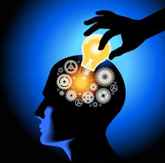
Segmenting information
Chunking
Breaking complex information into smaller pieces
ESL
Some researchers believe chunking can lead to native-like proficiency
Language Patterns
All languages contain word strings that stand alone as units of thought

Slide 106
Simplifying for Comprehension
Breaking down language makes it more comprehensible.
Paragraphs can be broken into sentences.
Sentences can be broken down into word strings.
Words can be broken down into syllables.

Slide 107
Sample of Word Strings
Prepositional Phrases
Subject-Verb
Verb-Direct Object
Adjectives-Nouns
Adverbs-Verbs

Slide 108

Word Strings
Prepositional phrases: with the soldiers, out of the bushes, across the night sky
Verb-Adverb: glanced outside, awoke too early, slept soundly
Adjective- Nouns: numerous little legs, heavy rain clouds, a steep rocky cliff
Verb-Direct Object: struck a tree, deposit money, illuminated the room

Slide 109
How Segmenting Works
The English teacher can breakdown paragraphs from any reading assignment. No special textbook or activities guide is needed.
The strategy for teaching these “word strings” is the same as for teaching vocabulary.
Students learn how to correctly pronounce each phrase or expression.
Visuals or mental pictures are connected to the sounds using pictures or associations.
It starts with oral comprehension.
Once each individual piece is mastered, the sentence is reconstructed with complete mastery.

Slide 110

Putting the Pieces Together
The following sentence is a collection of “word strings” presented earlier.
As the rain clouds drifted across the night sky, Jack glanced outside while lightning illuminated the room.
By itself, this is a fairly complex sentence that a student could struggle with.
But if a student first mastered the “chunks” that were presented earlier, he can read the entire sentence with little difficulty.

Slide 111
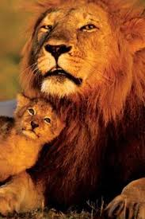
Segmenting Words
By breaking them down they seem less intimidating (in tim i dat ing).
SY NON Y MOUS
HI BER NATE
COM PRO MISE

Slide 112


Code Switching
Thinks of an answer in Vietnamese
Hears the information in English
Mentally translates it into Vietnamese
Speaks in English
Must mentally translate answer into English
Cycle repeats itself
Gets a reply in English
Must mentally translate reply into Vietnamese

Slide 113


Code Mixing
What is easier, adding a new word into your native tongue or learning a new language?
Relying on prior knowledge
Incorporate new language into native structures
The brain more willing to accept new information

Slide 114
Code Switching
Most beginning language learners engage in code switching.
The mind makes a distinction between the two languages.
Time is wasted and the results are inefficient.
A better strategy is to integrate the new language into the old language relying on prior knowledge.
This strategy is known as code mixing.

Slide 115
Samples of Code-Mixing
In theory, when a man and woman get married, they are forever verbunden- one soul that cannot be separated.
In English, a person’s Vorname comes before his Nachname- for example Robert STANGER.
But in Chinese it’s reversed. Der Nachname comes before dem Vorname- for example STANGER Robert.
Mt. Everest is the world’s highest Berg- over 10,000 meters. Many have tried den Berg zu steigen. Some have died trying. But those who steigen den Berg successfully place a flag on top.

Slide 116
Code Mixing
Past language theories discouraged code mixing. However, recent research demonstrates its benefits.
Connect new knowledge with prior knowledge and the brain is a willing participant.
Give the brain something new that doesn’t fit into well establish categories and it resists.
All languages incorporate foreign words.

Slide 117


Develop Meta-linguistic Understanding
What worked in first language learning
Skills are transferable, even if new language uses a different writing system

Slide 118
Meta-Cognition: Learning How to Learn
Meta-cognition
Creates depth and breadth of understanding
The key to mastery
Self-examination
Reflection and critical analysis of one’s own processes
Intimate knowledge of strengths and weaknesses
Meta-linguistic
Knowledge of natural language learning
Knowledge of one’s own innate intelligences

Slide 119

The Key to Mastering a Language
Self-awareness through self-reflection
Some people naturally develop these skills
Most people have to be taught
There are multiple learning styles
Which style matches your brain’s natural learning

Slide 120
Autonomous Learning
Student controls his own learning
By knowing one’s personal learning style- effective strategies can be developed
Requires monitoring one’s own learning
Assess what works and what doesn’t

Slide 121
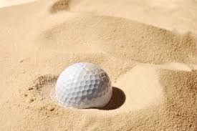
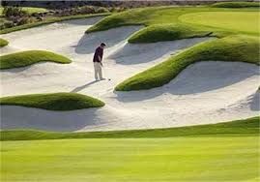
English Sand Traps
Homonyms
Collocations
Dialects
Slang
Euphemisms
Colloquialism

Slide 122
Problem Areas
Homographs
Please close the door.
Homophones
We walked to school.
Vowel Shift
Sit/site
Consonant Shift
Can you read the sign on the wall?
We are close to finishing our homework.
I want some too.
There are two possible choices.
Signal me when you are ready to go.
bit/bite
hat/hate

Slide 123
Homonyms
Homophones
Words that sound the same but are spelled differently
Jack went to the store. Sue wanted to go too. The two of them walked together.
Homographs
Words that are spelled the same but are pronounced differently
tie a bow/take a bow
close the door/move close to me

Slide 124
Denotative versus Connotative
Thin/Scrawny
Models are thin.
Bulimic women are scrawny.
Curious/Nosey
Children and scientist are curious.
Next door neighbors are nosey.
Thrifty/Cheap
You, when you won’t lend your brother money.
You, when you won’t lend your brother money.
(depends on who you ask)

Slide 125

Negative versus Positive Meanings
Words can have similar denotative but opposite connotative meanings.
A connotative meaning is an emotional feeling that is part of a word. It can be positive or negative.
ESL students must be aware of these differences as a listener could be confused or even unintentionally insulted.

Slide 126
Example of Slang
Jack is the baddest basketball player in the hood.
This actually means that Jack is the best.
“Hood” is slang for neighborhood.
Those shoes are lit.
This means you like Sue’s shoes.
Example of old words taking on new meanings.
I really like Mario. He has Rizz. No cap.
Rizz= Charisma
No cap= no lying.

Slide 127



Slang
In order to separate themselves from their parents and gain their independence, teenagers invent new words or give old words new meanings
Most slang words disappear after a few years, but occasionally a word sticks. In recent years Bling and Phat have shown some staying power.
Slang is oral in nature, is rarely written, and should not be used in formal situations

Slide 128
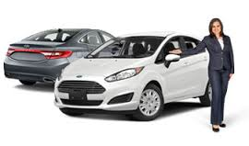
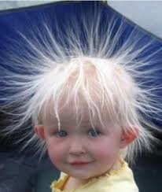
Euphemisms
Indirect communications designed to obscure the speaker’s meaning
Sanitation Engineer
versus
Garbage Collector
Previously Owned Vehicle
versus
Used Car
That’s an interesting haircut!
Friendly Fire
or
Engaging the Enemy on All Sides

Slide 129
Colloquialisms
Very informal, polite conversation
An understanding of them is absolutely necessary for conversational fluency
Common expressions used frequently in everyday conversation
Make no sense from the words or context. ESL student must actively learn them
Express jokes, sarcasm, anger or exaggeration
There are excellent books with an extensive collection of useful phrases
Can’t be found in dictionaries or grammar books
They convey large amounts of information, and like idioms, are a quick and easy way to make a point

Slide 130
Colloquialisms: Concepts and Situations
Keep your shirt on!
It’s off the beaten track.
No sweat!
My lips are blue.
Are you for real?
Can I bend your ear?
What’s the bottom line?
Get out of here!
We’ll cross that bridge when we come to it.
It’s a stone’s throw away.
You’re way off base!
Blood runs thicker than water.
You can’t fight city hall.
She’s ‘smokin’.
I’ll try not to spend it all in one place.
Don’t give it another thought.
Where you been hiding?
Don’t blow a gasket!

Slide 131





Standard American English
The English spoken by newscasters and written in most newspapers
SAE is understood by most Americans
The English taught in most EFL classes internationally
The English use in most grammar and English workbooks
There’s only one problem with teaching SAE overseas

Slide 132


FEW AMERICANS ACTUALLY SPEAK IT!!!!
Lack of cultural knowledge
No exposure to dialects or colloquial speech
Confusion for international students

Slide 133




Linguistic Variations in American English
Even speakers of American English will not use language in the same way
We call these variations within a language dialect

Slide 134
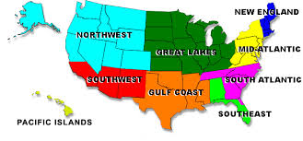
American English Dialects
Most of us associate dialect with region and the way words are pronounced.
There are 9 recognized variations of American English

Slide 135
Linguistic Variation in American English
We call variations in pronunciation accents- but accents are just a part of what makes up a dialect.
Differences in pronunciation, word meaning, word order, and even grammar can exist among American speakers.

Slide 136

Regional Variations of American English
A soft drink can be called “coke”,
“soda”, or “pop”- depending on the
region of the U.S.
* English has no plural for the word “you”. Therefore, each region creates its own version. An international student could hear “yall”, “youz”, or “yinz” depending on the region of the U.S.
* Word order is also affected. For example, in some larger cities a student might hear “This I need” instead of the standard “I need this”.

Slide 137
Sentence Condensation
English speech will condense and combine words or phrases that sound significantly different that the standard English that the students are exposed to in EFL classes.
“Ya wanna go to dah movies?” (Do you want to go to the movies?)
“I’m gonna try mah best” (I am going to try my best)
‘Jah eet” (Did you eat).
Nice ta meecha (Nice to meet you)
I dunno (I don’t know)
This phenomenon is NEVER taught in EFL classes because it deviates from the standard.
But this is the real spoken English students will hear. By not introducing students to this reality, we are not preparing them and delaying their integration into American society.

Slide 138
Non-regional Dialects
Occupational Dialects
Age Dialects
Gender Dialects
Educational Dialects
Dialects of Social Status

Slide 139


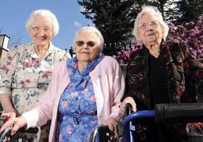

Occupation and Age Dialects
When a computer programmer uses the words “bug” or “virus”, he means something quite different than a doctor or exterminator.
For the young and the old, words can have different meanings. For an older person the word “bad” means something negative, but for a young person- it can mean excellence.

Slide 140





Gender and Social Dialects
There as such a thing as male words and female words. A man rarely uses the word “adorable”
People in the upper class “perspire” when they are hot. Working class people “sweat.”

Slide 141
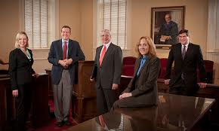
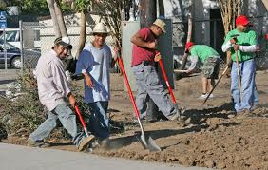
Educational Dialect
The more educated a person is- the more likely they will use Tier Two and Tier Three words.
“We are exhausted” “We’re tired”
Advanced students should know about these distinctions

