Slide 1




Establish a Teacher Learning Community Robert Stanger North Central University
Professional Development
Series

Slide 2
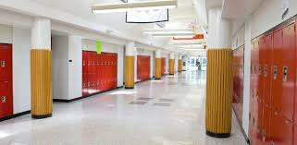
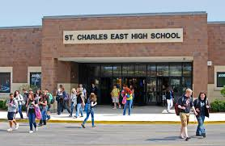
Objectives and Focus

Slide 3
Teacher Learning Communities Theory and Philosophy
There is power in collective intelligence (Dufour, Dufour, Eakert, & Karhanek, 2004).
Harnessing the collective power of school communities can solve problems.
Developing a dual language immersion program requires the collective efforts of all
stakeholders (Caldeon & Minaya-Rowe, 2004).
Innovative new methods based on proven research must replace traditional
approaches when it comes to giving cultural and linguistic minorities equal access to
curriculum content (Diaz-Rico & Weed, 2010).
Teacher learning communities help districts develop a shared mission, common
vision, universal values, and comprehensive objectives (Dufour, Dufour, Eakert, &
Karhanek, 2004).
TLC assists in establishing explicit targets and reasonable timelines.
Staff takes control over their own development and connects their activities directly
into affecting student outcomes (Calderon & Minay-Rowe, 2004).

Slide 4
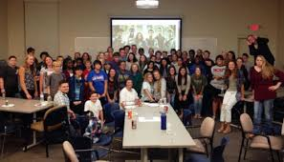

Develop School-wide Teacher Learning Communities (TLC)

Slide 5
Collaborative Teams of Stakeholders
Team members operate interdependently to realize shared objectives (Dufour,
Dufour, Eakert, & Karhanek, 2004)
The school wide capacity to change is a collective endeavor rather than an
individual one (Calderon & Minaya-Rowe, 2004)
Individuals gain insights from discussion and debate that generates
organizational progress
TLCs engage in collective enquiry and shared discovery into best practices in
two-way language immersion and program implementation (Dufour, Dufour,
Eakert, & Karhanek, 2004)
TLC communities challenge status quo, research new methods, experiment
with innovative strategies, and reflect on findings (Calderon & Minaya-Rowe,
2004).
Action research produces data specific to the needs and challenges of the
community and school district (Mertler & Charles, 2011)

Slide 6



TLC Discussion Points (Calderon & Minaya-Rowe, 2004)

Slide 7
TLC Goals and Objectives (Calderon & Minaya-Rowe, 2004)
By creating a collaborative mindset among administrators, staff, and students, a two-way immersion curriculum shall be fully integrated into the school culture.
Second language learners will have access to the same curriculum standard subject content, and learning objectives as traditional students
Objectives one and two shall be facilitated by practicing additive language and cultural learning through making use of the students’ language, experiences, and background knowledge.
Objectives one and two shall be facilitated by keeping all teachers current on the latest language learning and linguistic development theories, as well as strategies and activities for implementing those theories in the classroom.
Teachers take active role in identifying areas of exploration and administration ensures resources and time are available.

Slide 8


TLC Professional Development Timeline Bilingual Education (Dufour, Dufour, Eakert & Karhanek, 2004)

Slide 9
TLC Evaluation of Assessment Practices (Herrera, Murray, & Cabal, 2007)

Slide 10
TLC Professional Development Understanding Bilingualism (Diaz-Rico& Weed, 2010)

Slide 12
Bilingual Intervention

Slide 13


Improving Oral Comprehension (Bilingual Intervention) (Haley & Austin, 2014)

Slide 14




TLC Professional Development Classroom Strategies

Slide 15
Keystone Adolescent Center ( TLC in Action)
Keystone is a charter school specializing in the at-risk population.
At-risk students’ academic literacy levels are generally two years behind
mainstream populations.
The school embraces innovative strategies and experimental approaches and in
2008 adopted the Professional Learning Community initiative.
Small group meetings comprised of members from various departments
occurred monthly.
In large group staff meetings, members shared and discussed findings of small
group assignments with topics presented by video or guest speakers.
Presentations were analyzed, critiqued, and evaluated.
Many teachers gained insight from these meetings and changes were made
inside the classroom that resulted from these insights.
However, some teachers were reluctant to change and few even provided
negative feedback.
While the administration did a good job in presentation, modeling, and
promoting group discussion, peer visits, and feedback: it provided no classroom
coaching.

Slide 16



TCL Discussion Questions

Slide 17
References
Calderon, M.E. & Minaya-Rowe, L. (2004). Designing and implementing two-
way bilingual programs. Thousand Oaks, CA: Corwin Press.
Diaz-Rico, L.T. & Weed, K.Z. (2010). The cross-cultural, language, and
academic development handbook. Boston, MA: Pearson.
Dufour, R.,Dufour, L., Eaker, R., & Karhanek, G. (2004). Whatever it takes.
Bloomington, IN: Solution Tree.
Haley, M.H. & Austin, T.Y. (2014). Content-based second language learning. An
interactive approach. Upper Saddle River, NJ: Pearson.
Herrera, S.C., Murray, K.G., Cabal, R.M. (2007). Assessment accommodations
for classroom teachers of culturally and linguistically diverse students.
Boston, MA: Pearson.
Mertler, C.A. & Charles, C.M. (2011). Introduction to education research.
Boston, Ma: Pearson Education, Inc.

