Slide 1

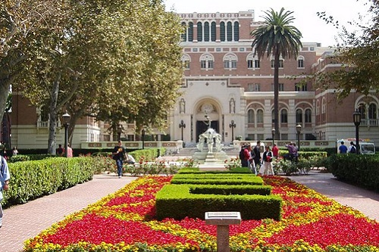


Understanding American Culture Series
What is a Liberal Arts Education

Slide 2

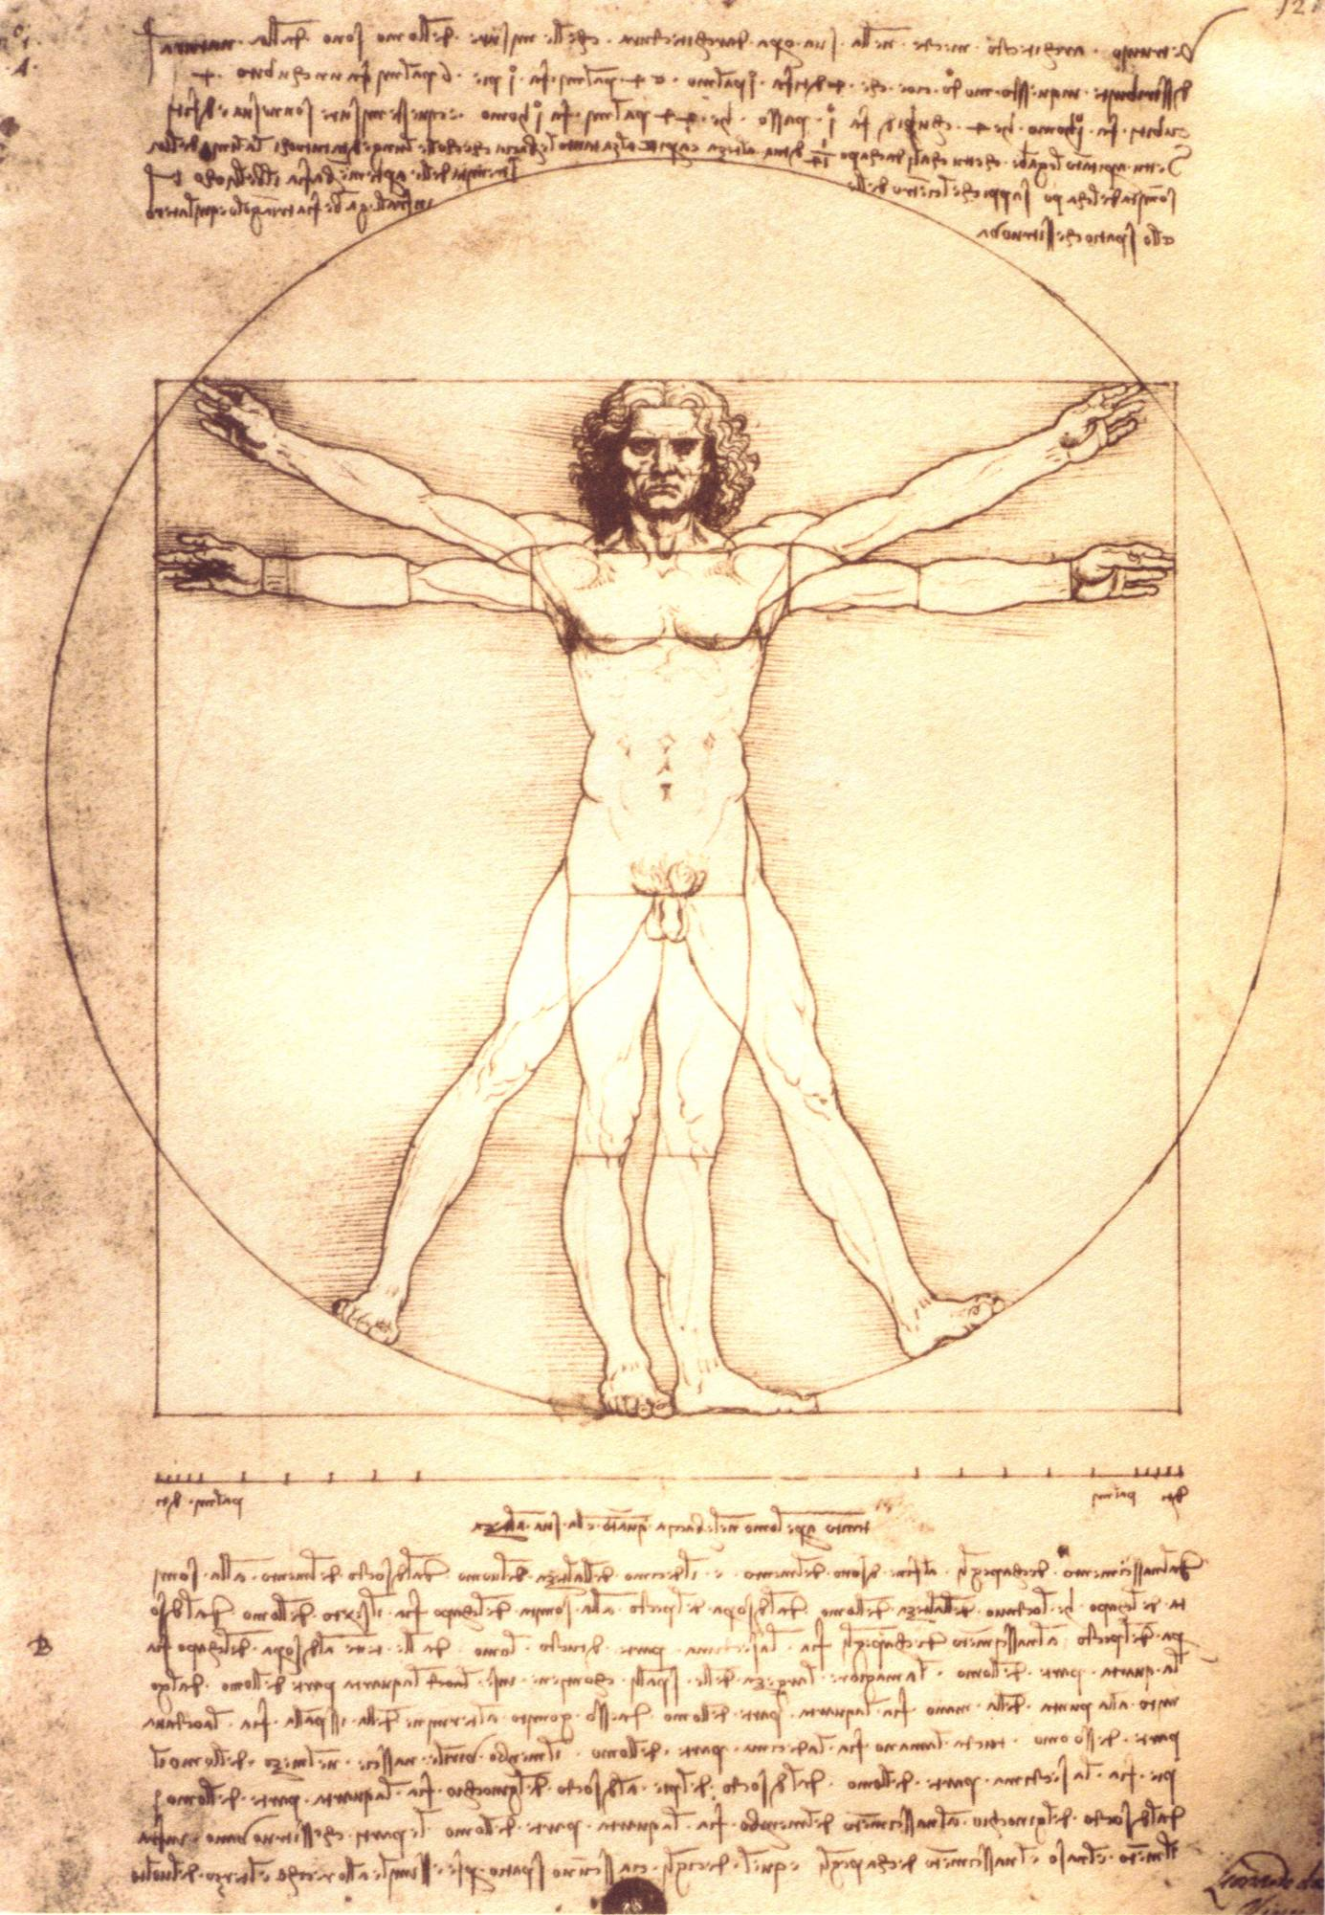


Human Existence
BODY (physical nature)
SPIRIT (subjective emotion)
MIND (rational thought)

Slide 3
The Ancient Greeks To maximize potential- A student must: Develop Everything
Discipline the mind
(logic, mathematics, science)
Develop the body
(sports, exercise, health)
Strengthen the Spirit (philosophy, ethics, art)

Slide 4
Exposure to multiple disciplines
See the world from multiple viewpoints
Have the ability to analyze and interpret
Become a free thinker

Slide 5
What do these three men have in common?
Creator of Microsoft
Creator of Apple Computers
and
I Phones
Discovered the Theory of Relativity

Slide 6
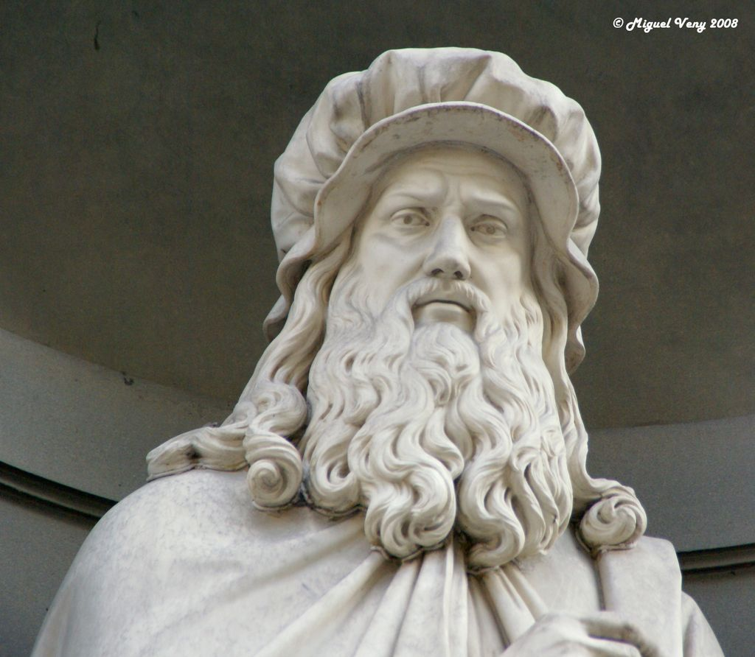
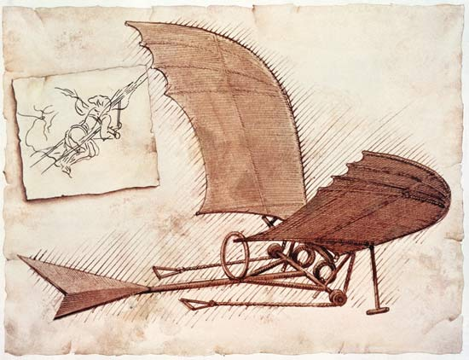
They Solved Problems
Critical thinker
Innovative thinker
Creative thinker

Slide 7
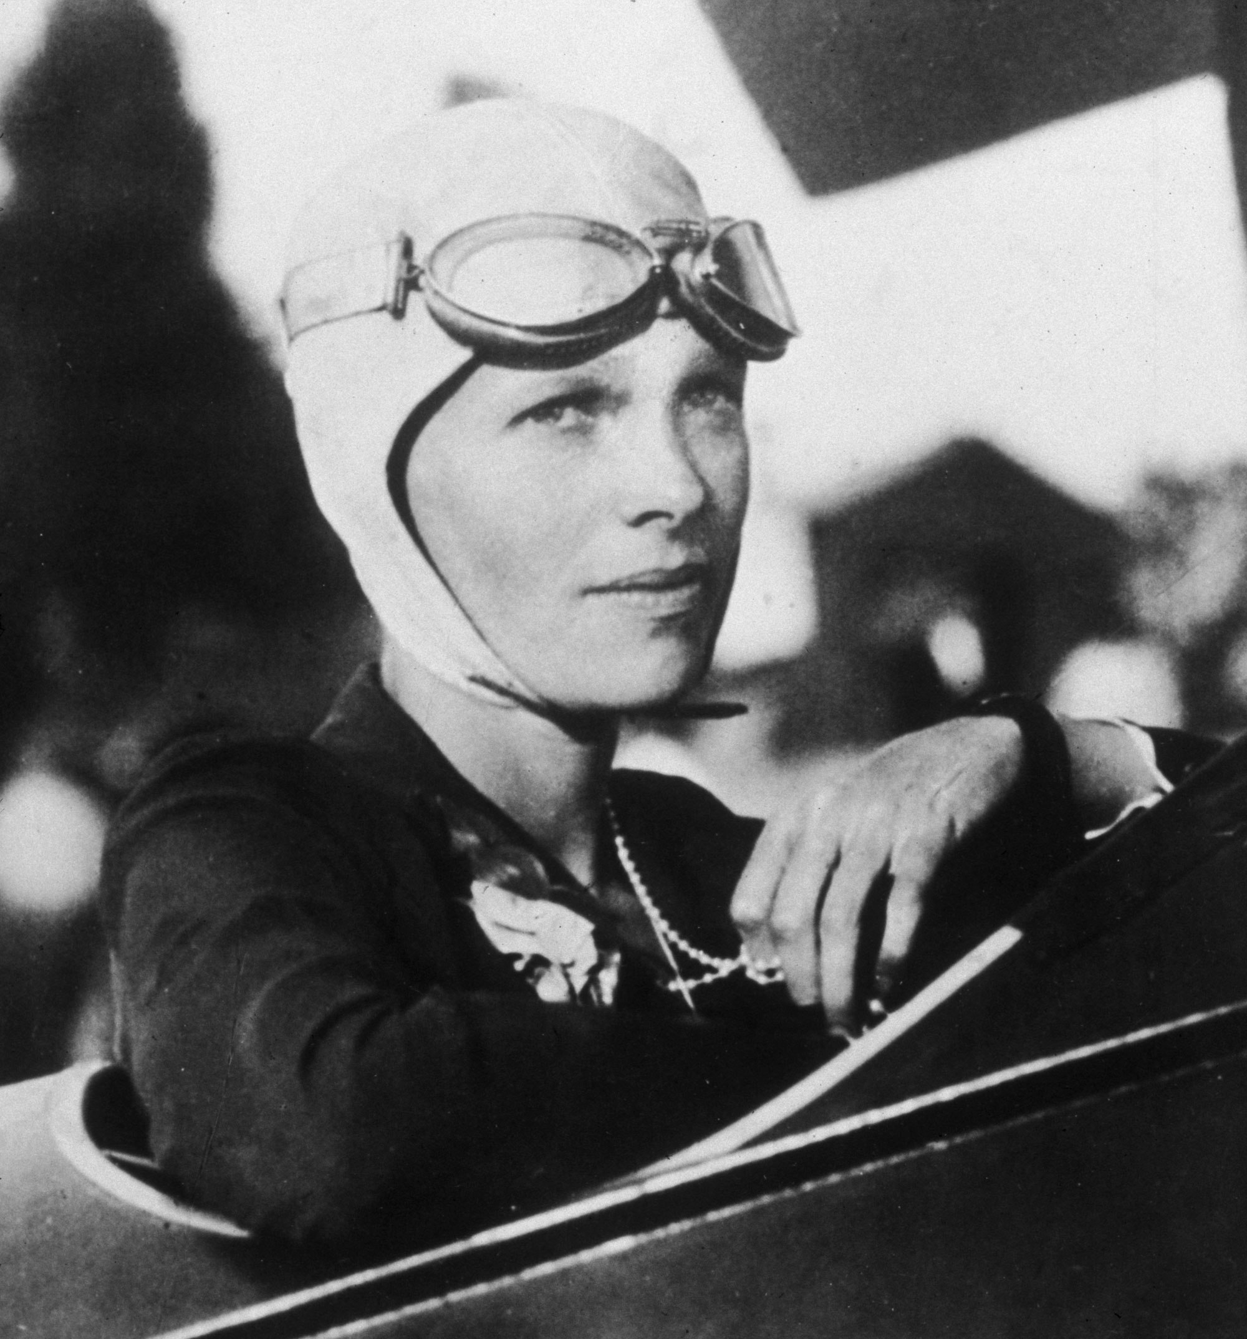
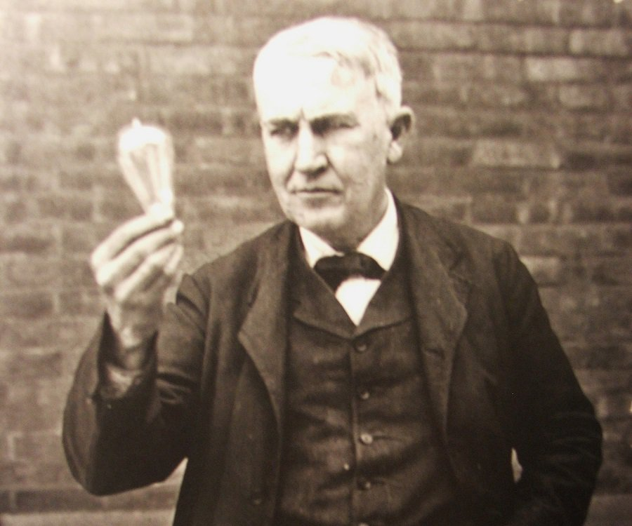
Break Boundaries
Old problem require new perspectives
Reject
group think. Follow your instinct even when everyone else says you’re wrong
Free Thinker
No one tells you what to believe.

Slide 8
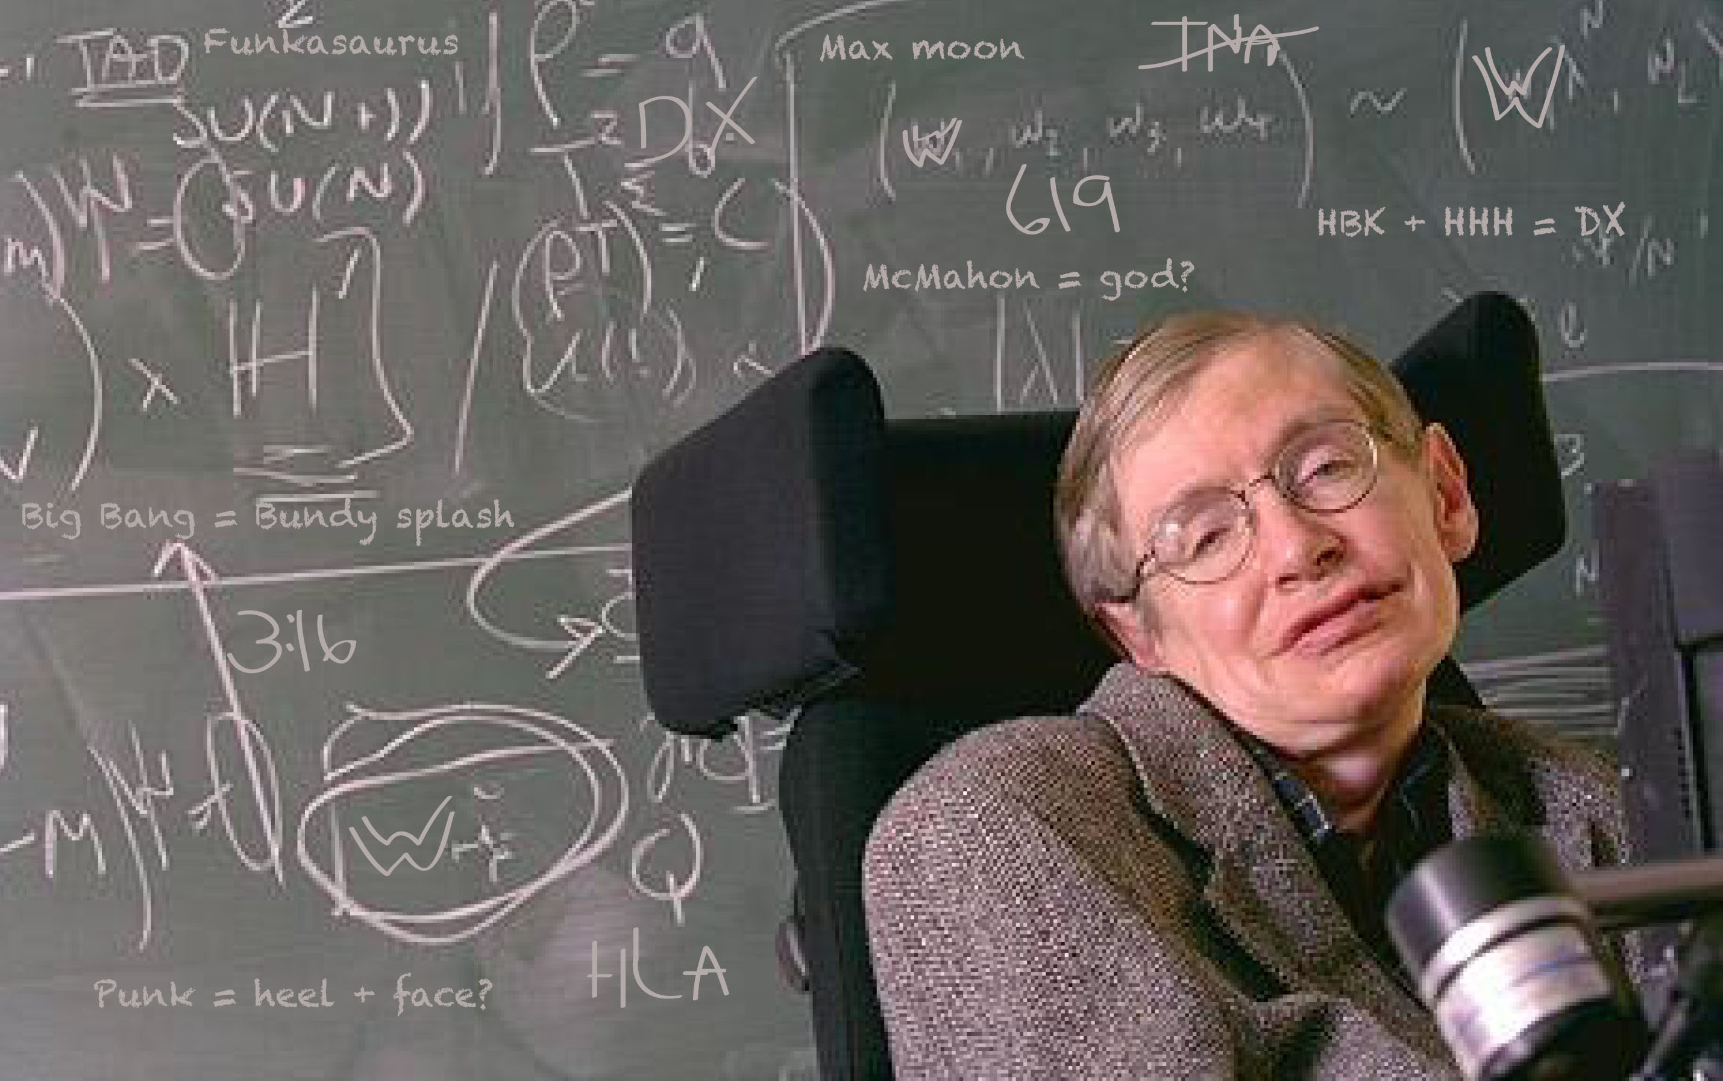
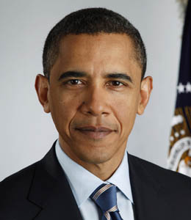
Change the World
Refuse to be ordinary
Refuse to accept limits
Focus on the future by understanding the past- not by living in the past
Refuse to be silent

Slide 9
“If I see further than others, it’s because I stand on the shoulder of giants”
Sir Isaac Newton
Discovered the theory of gravity
Hippocrates
Founder of modern medicine
Aristotle
Father of Physical Sciences

Slide 10
No Limits
Critical Thinker
1. Question everything 2. Analyze from multiple perspective 3. Understand what works and what doesn’t
Free thinker
Develop an understanding build on knowledge that is both broad and deep
Creative Thinker
Heightened awareness- you see things others fail to see
Free from the old thinking- the ability to see thing from new perspectives
Combine intelligence and imagination
Free from the opinions of others- can see their strengths and weaknesses

Slide 11


Forbes Facts
One third of all Fortune 500 CEOs have Liberal Arts Degrees
More likely to get into higher ranking graduate schools
Have wider skill sets and outperform peers who specialize
Have greater critical thinking skills and creativity
More likely to get promotions
Are better at persuasive communication

Slide 12

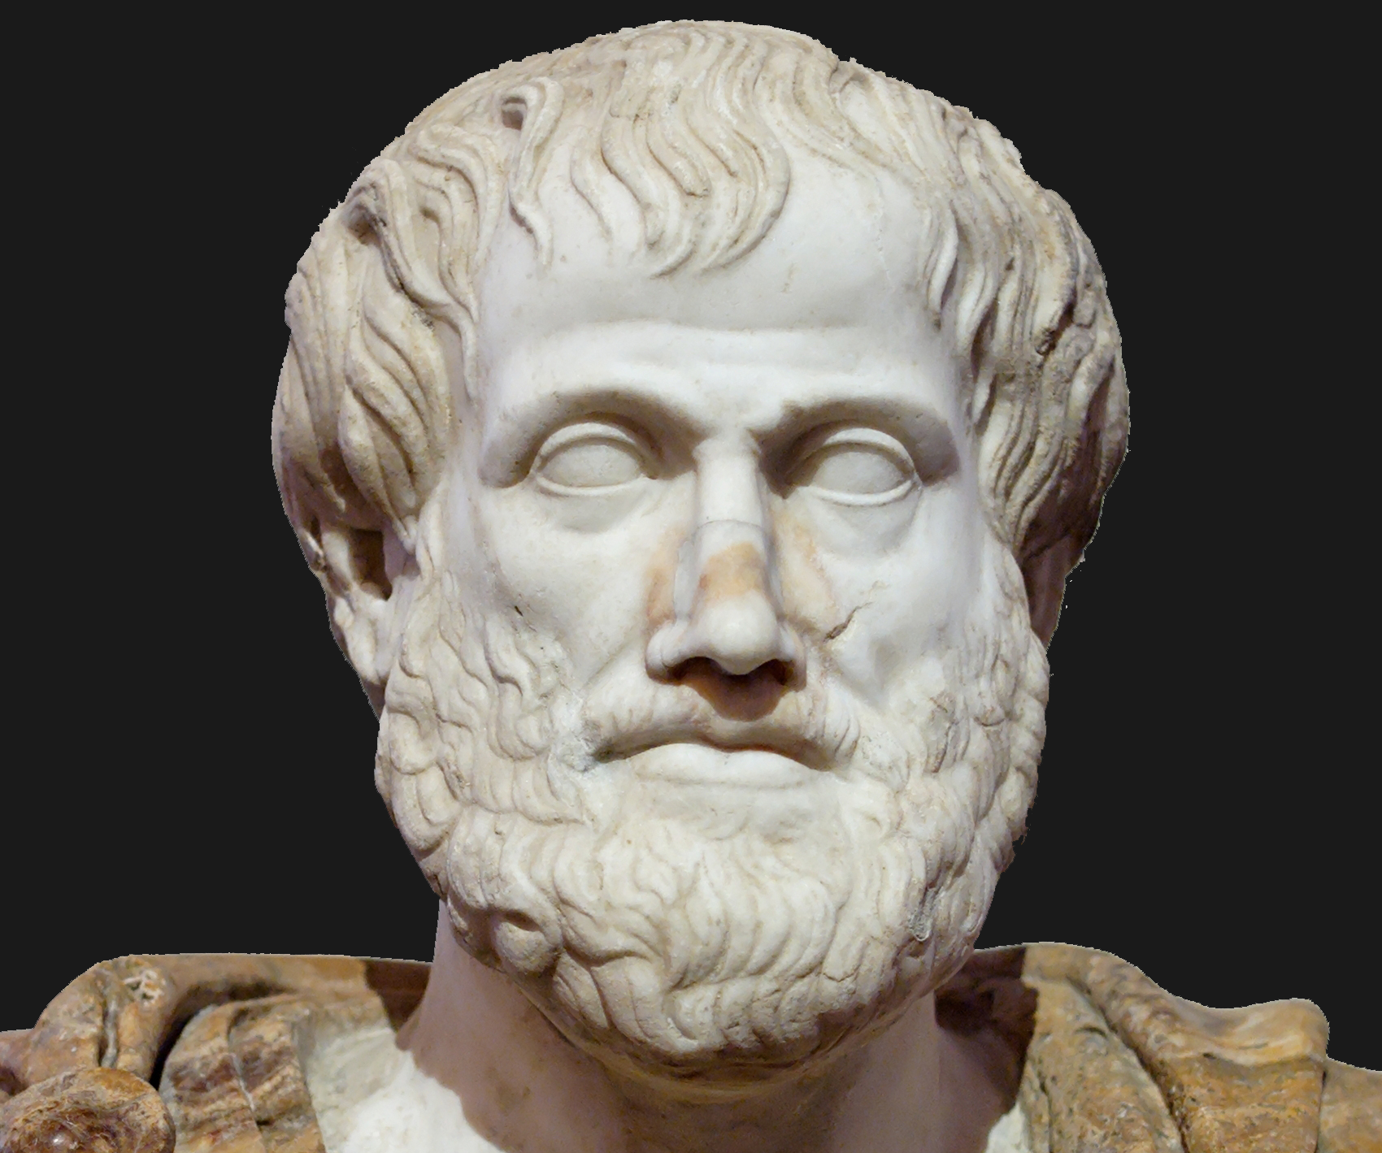

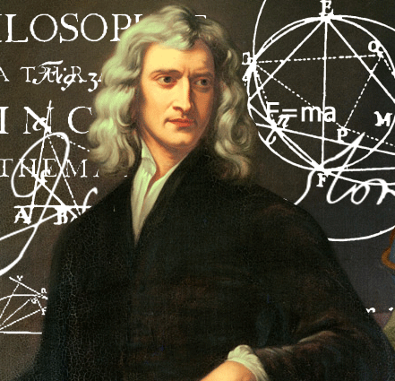
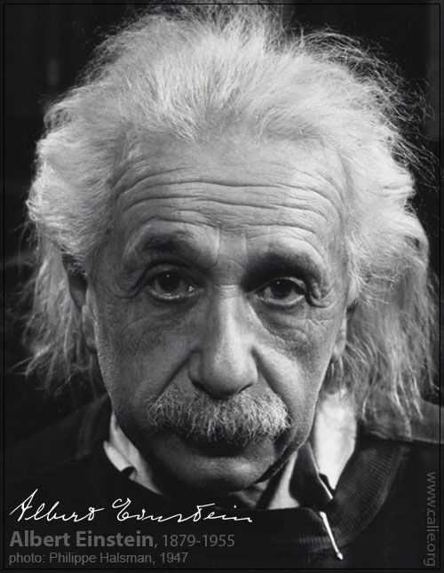
Liberal Arts Education 2,000 years of discovery

