Slide 1

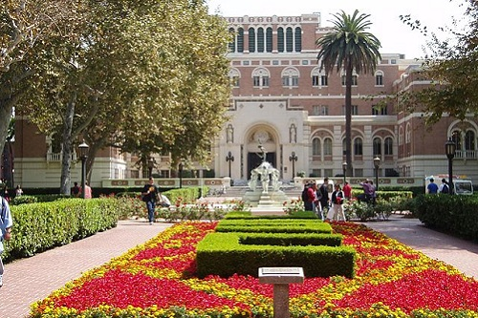
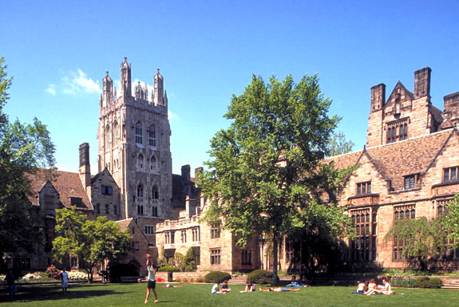

Understanding American Culture Series
What is a Liberal Arts Education

Slide 2

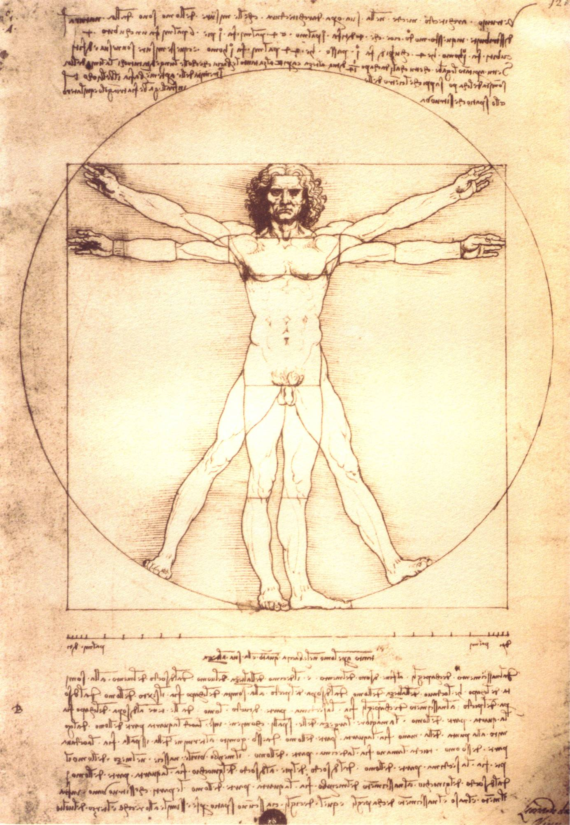


Human Existence
MIND (rational thought)
BODY (physical nature)
SPIRIT (subjective emotion)

Slide 3
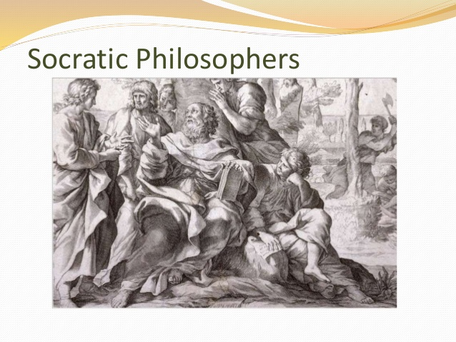
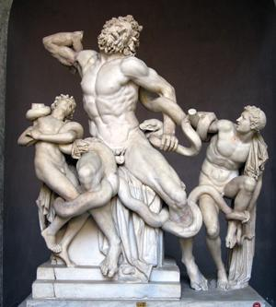
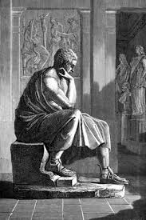
The Ancient Greeks To maximize potential- A student must: Develop Everything
Discipline the mind
(logic, mathematics, science)
Develop the body
(sports, exercise, health)
Strengthen the Spirit (philosophy, ethics, art)

Slide 4



Exposure to multiple disciplines
See the world from multiple viewpoints
Have the ability to analyze and interpret
Become a free thinker

Slide 5
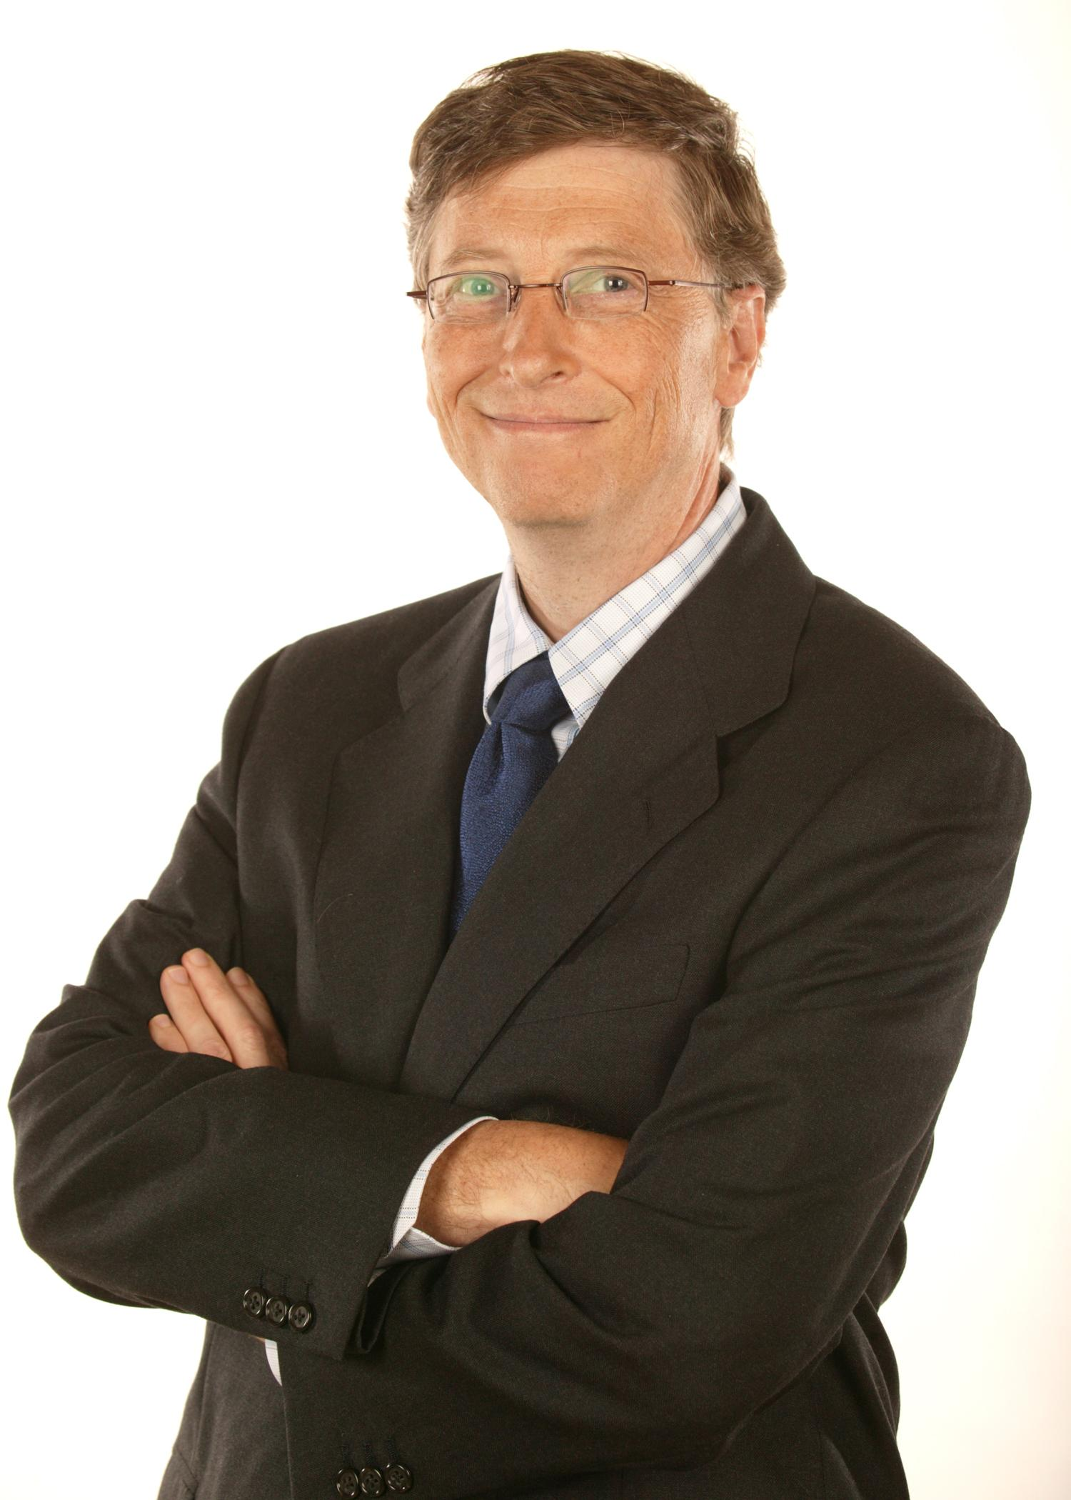
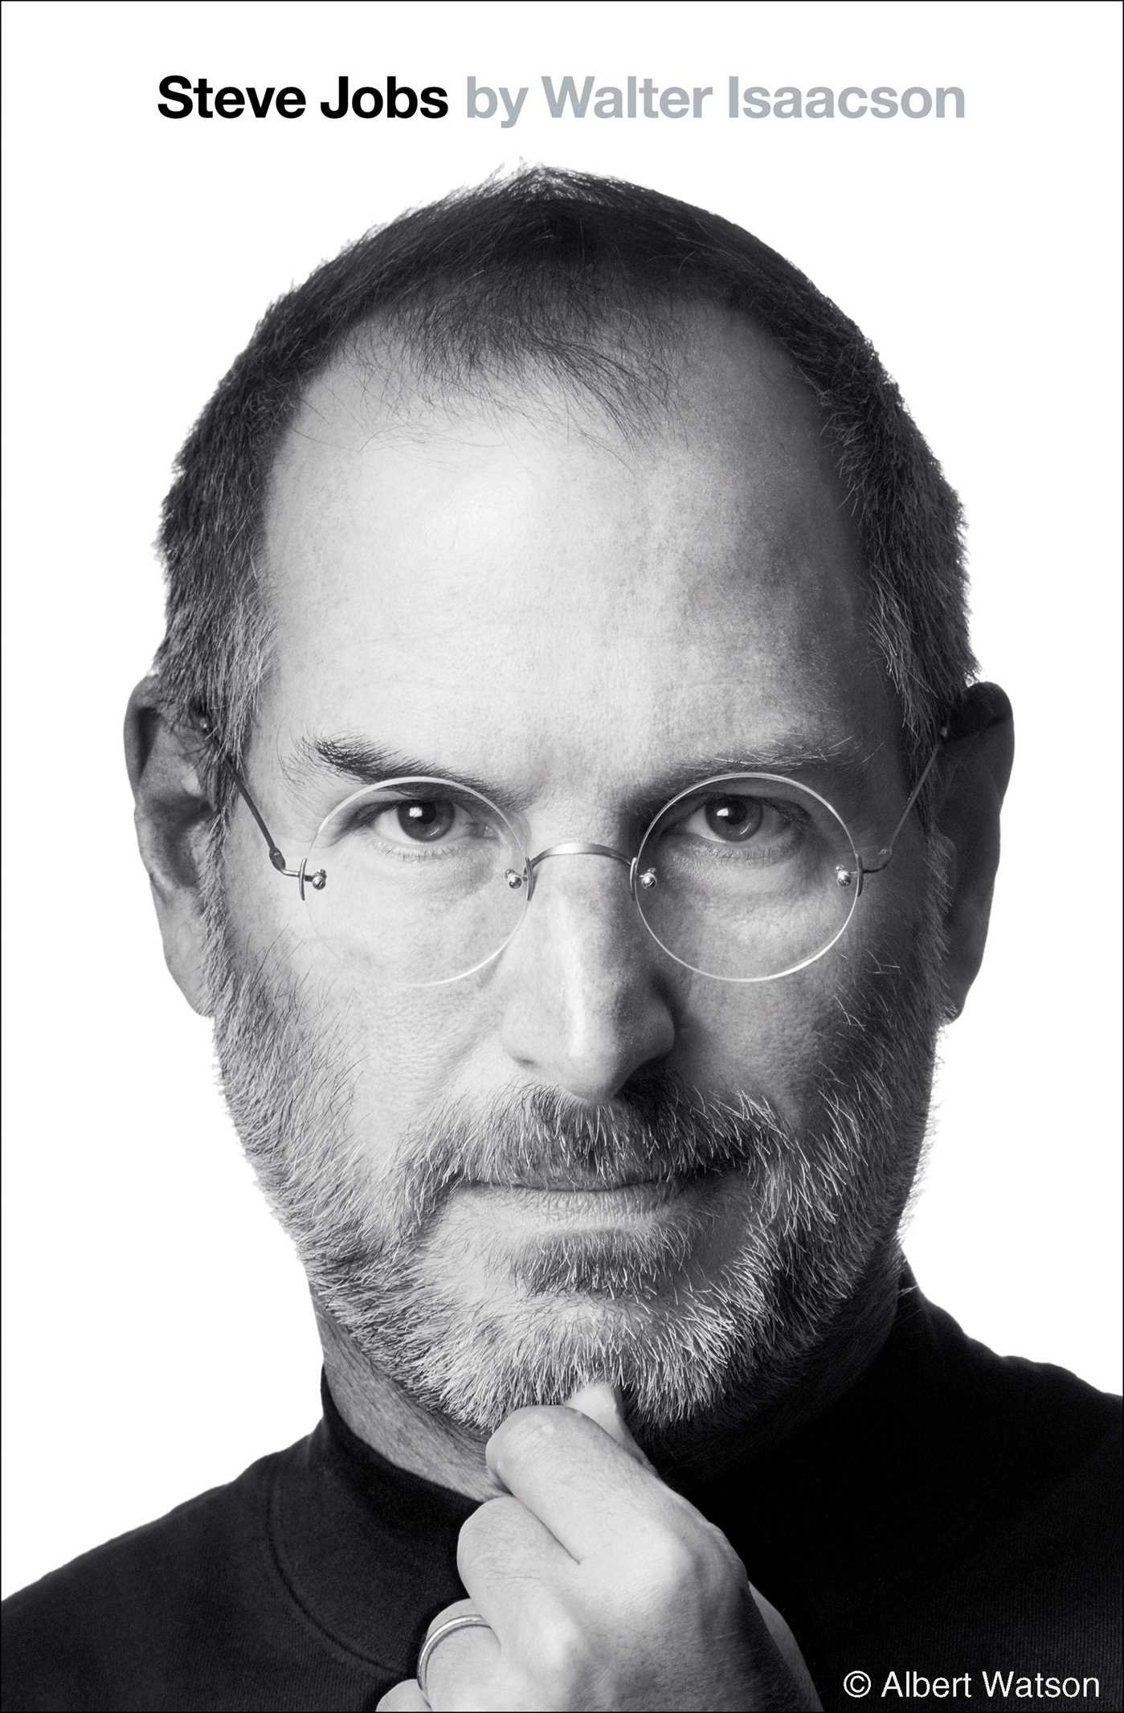
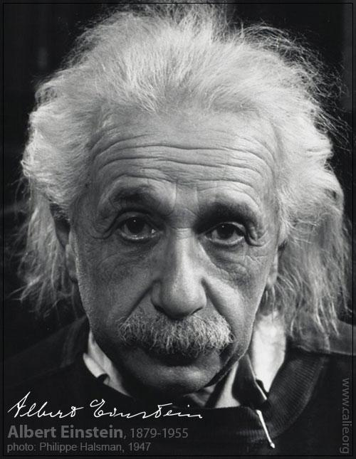
What do these three men have in common?
Creator of Microsoft
Creator of Apple Computers
and
I Phones
Discovered the Theory of Relativity

Slide 6
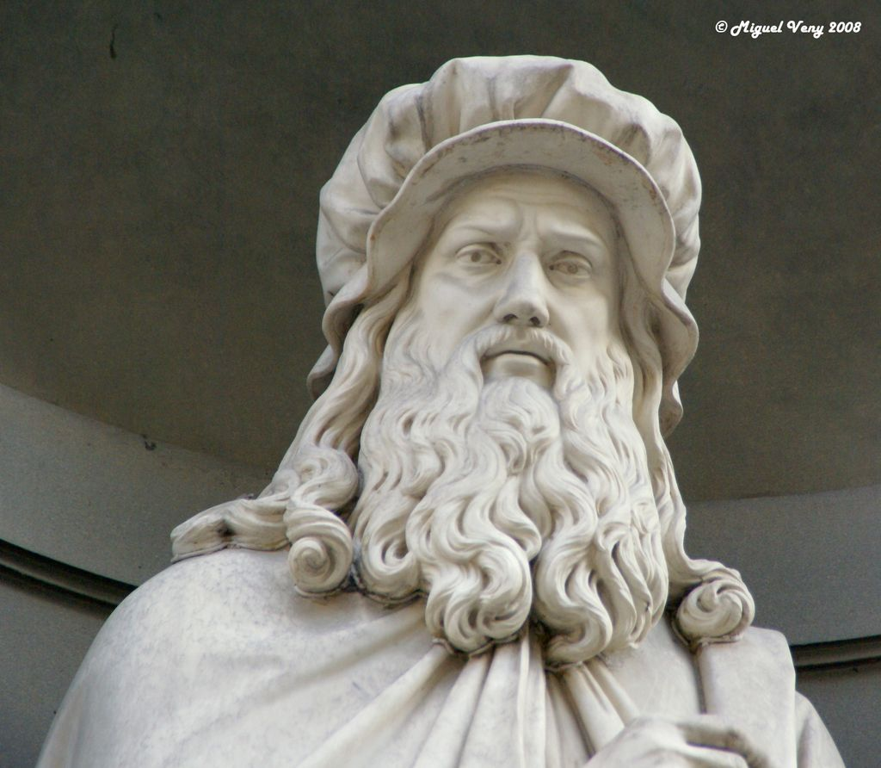
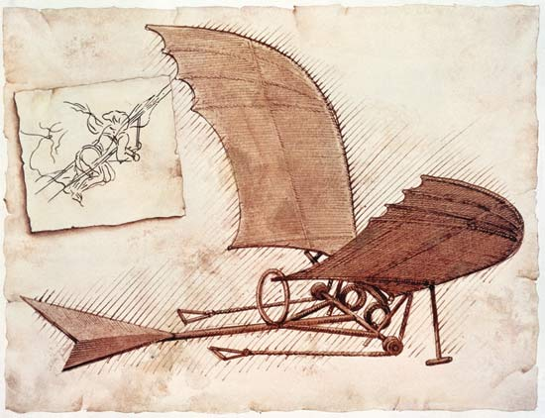
They Solved Problems
Creative thinker
Innovative thinker
Critical thinker

Slide 7
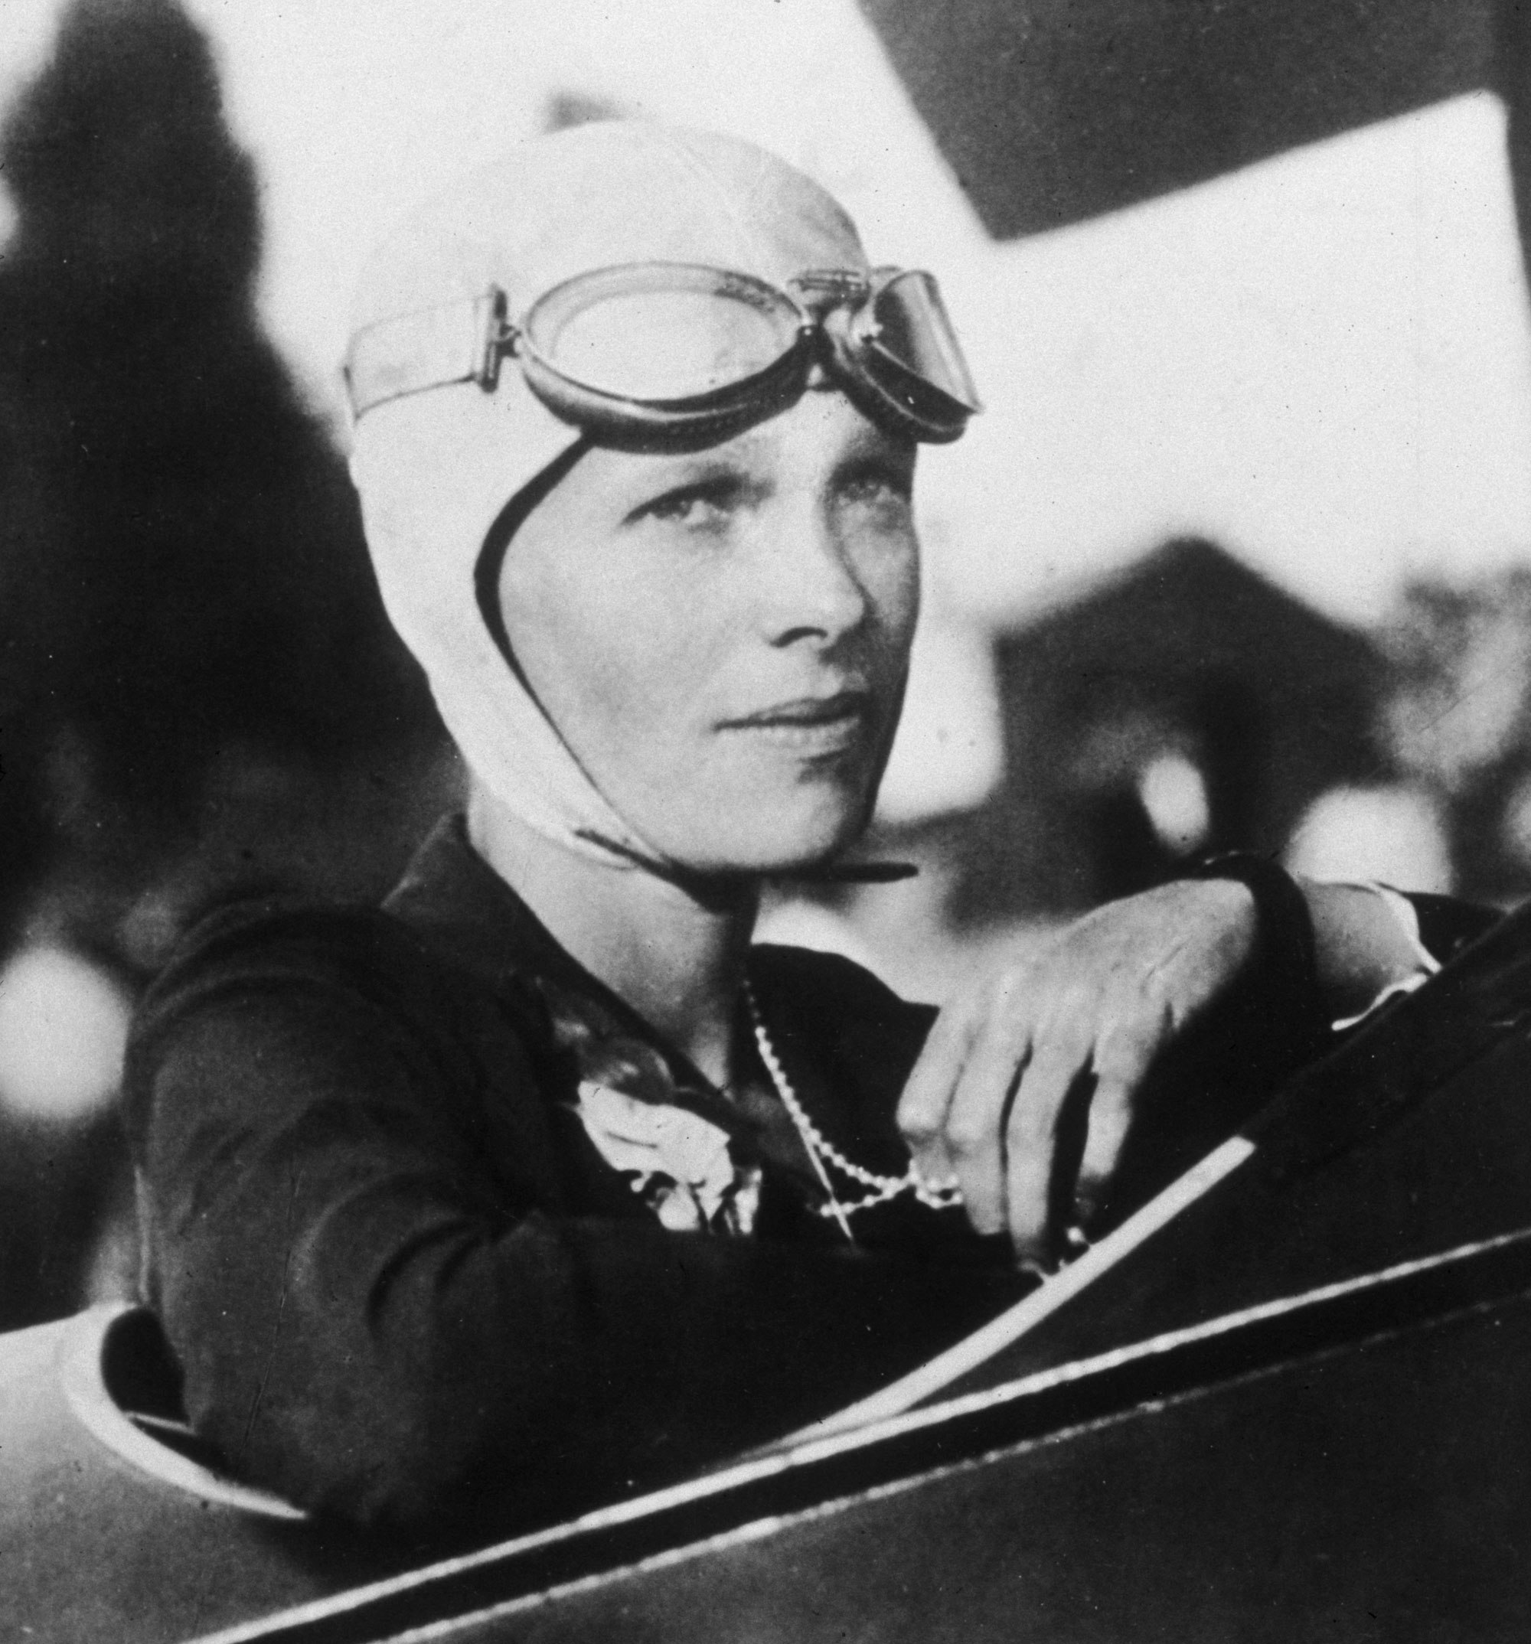
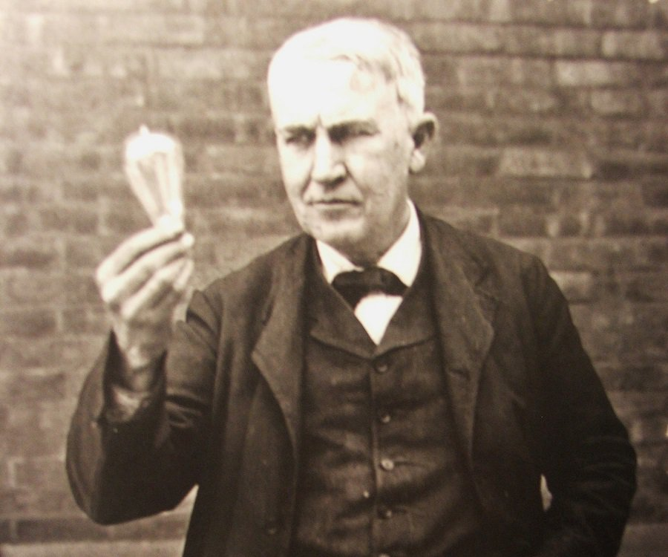
Break Boundaries
Free Thinker
No one tells you what to believe.
Reject
group think. Follow your instinct even when everyone else says you’re wrong
Old problem require new perspectives

Slide 8
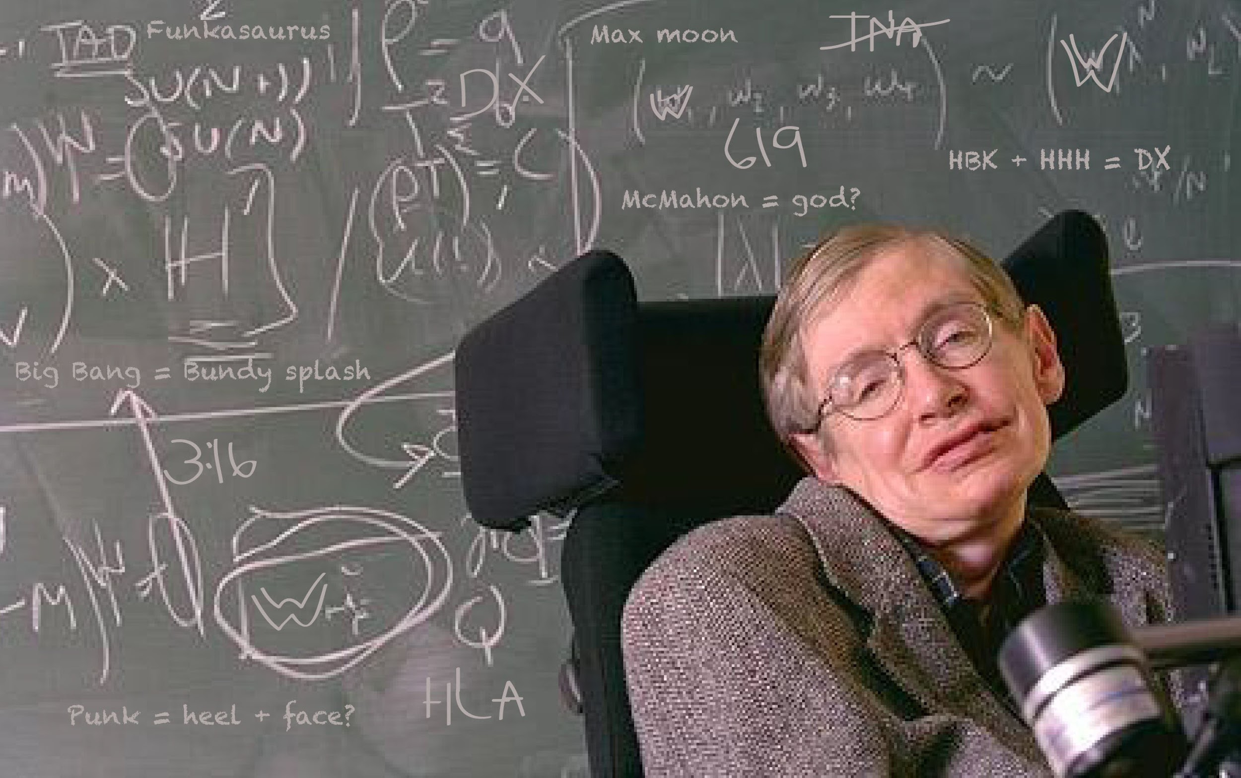
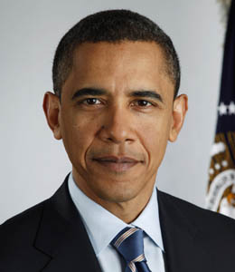
Change the World
Refuse to be ordinary
Refuse to accept limits
Refuse to be silent
Focus on the future by understanding the past- not by living in the past

Slide 9
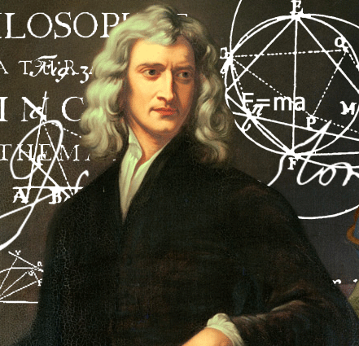
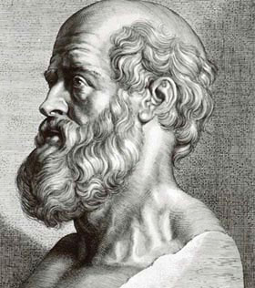
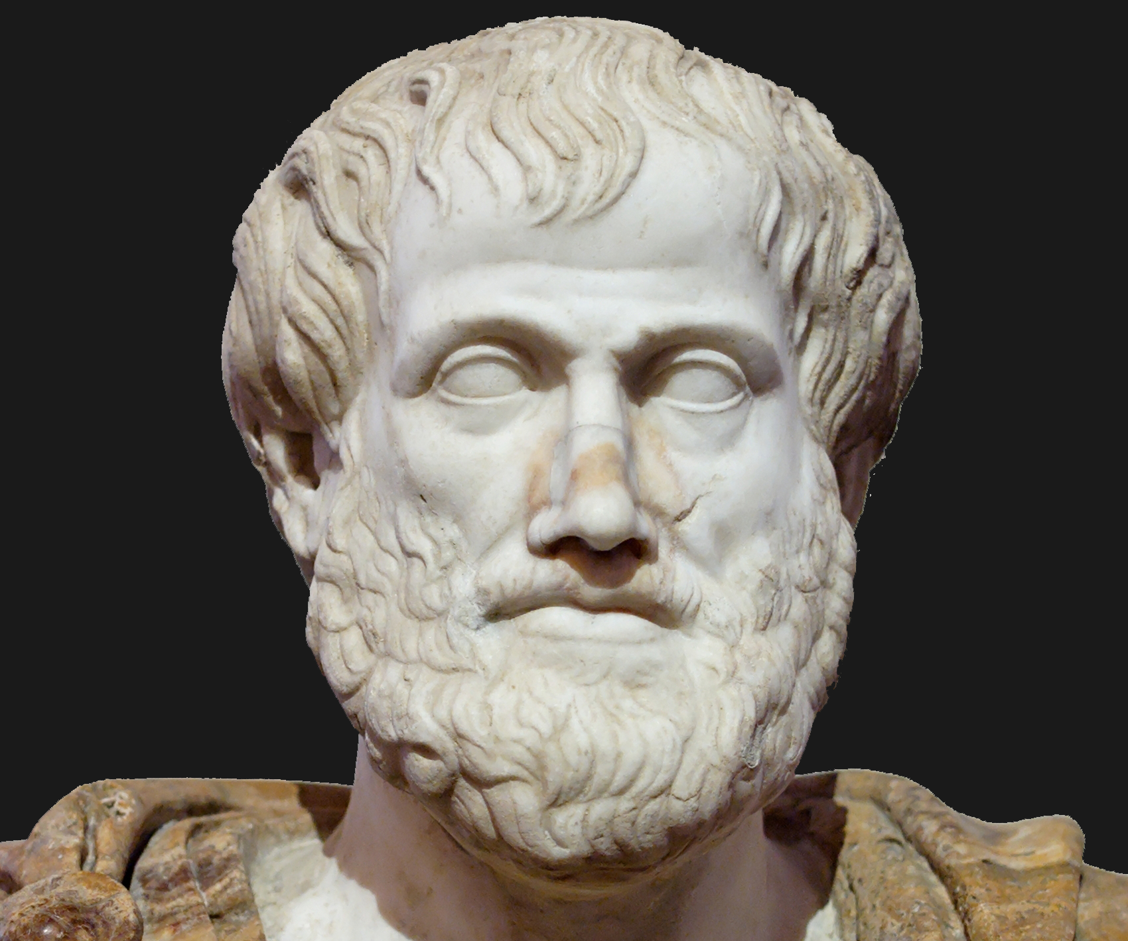
“If I see further than others, it’s because I stand on the shoulder of giants”
Sir Isaac Newton
Discovered the theory of gravity
Hippocrates
Founder of modern medicine
Aristotle
Father of Physical Sciences

Slide 10
No Limits
Critical Thinker
1. Question everything 2. Analyze from multiple perspective 3. Understand what works and what doesn’t
Free thinker
Develop an understanding build on knowledge that is both broad and deep
Free from the opinions of others- can see their strengths and weaknesses
Creative Thinker
Heightened awareness- you see things others fail to see
Combine intelligence and imagination
Free from the old thinking- the ability to see thing from new perspectives

Slide 11


Forbes Facts
Have wider skill sets and outperform peers who specialize
More likely to get into higher ranking graduate schools
Have greater critical thinking skills and creativity
One third of all Fortune 500 CEOs have Liberal Arts Degrees
More likely to get promotions
Are better at persuasive communication

Slide 12

Liberal Arts Education 2,000 years of discovery

