Slide 1
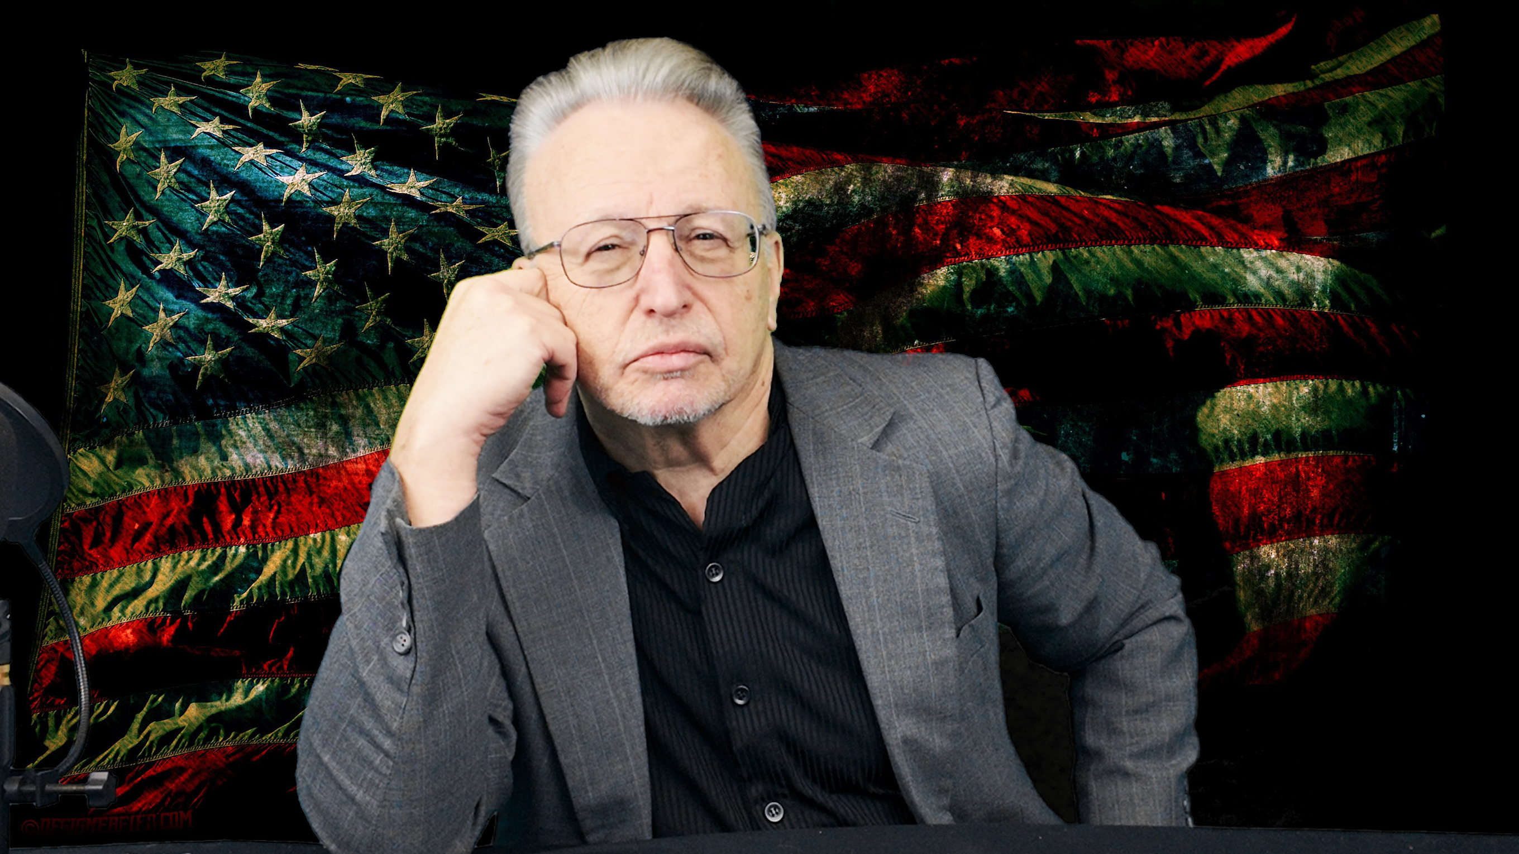
Super english
Language is a Super Power
Robert Stanger M.Ed.

Slide 2
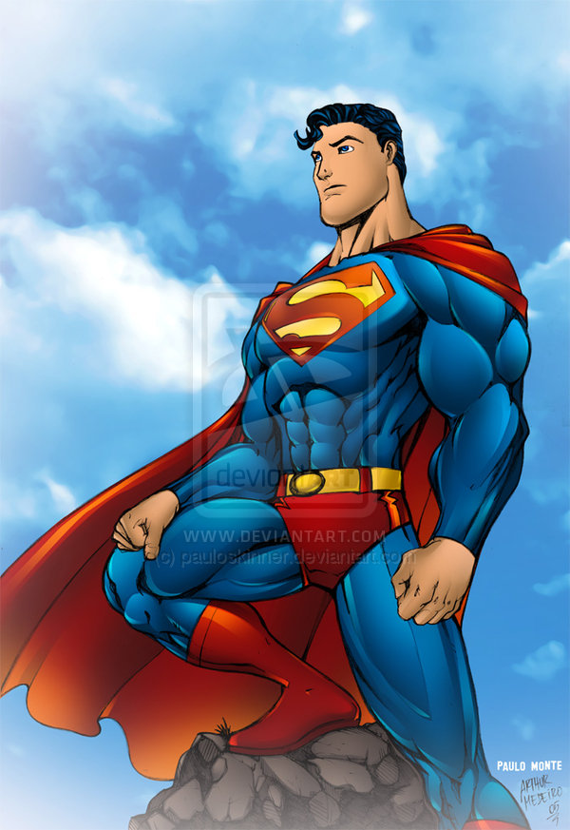
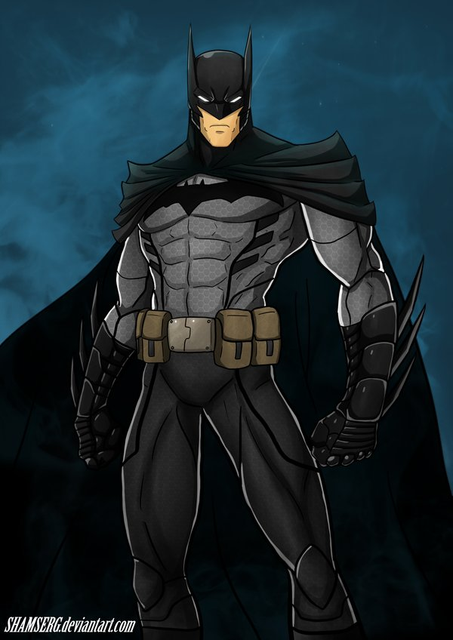
Describe the Superhero

Slide 3
Superhero Quiz
What colors are Superman’s costume?
A. Red, white, and blue
B. Red, blue, and yellow
C. Blue, grey, and black
Who is stronger- Superman or Batman?
Which superhero has the coolest car?
Which superhero is very rich?

Slide 4
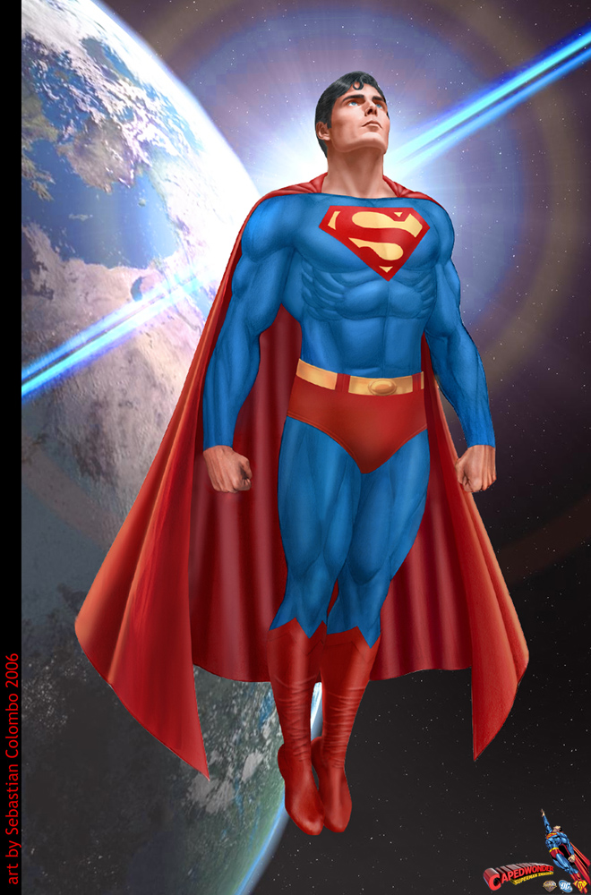
Super Quiz
Which is not a power Superman has?
A. super strength
B. super speed
C. the ability to read minds
D. the ability to fly

Slide 5
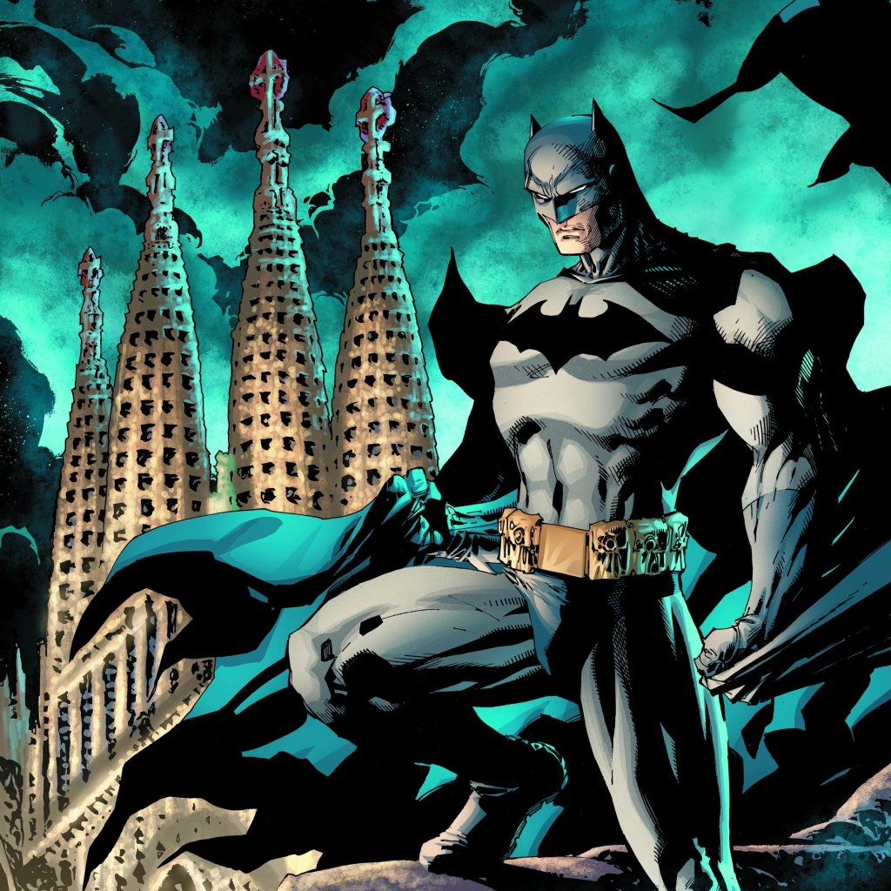
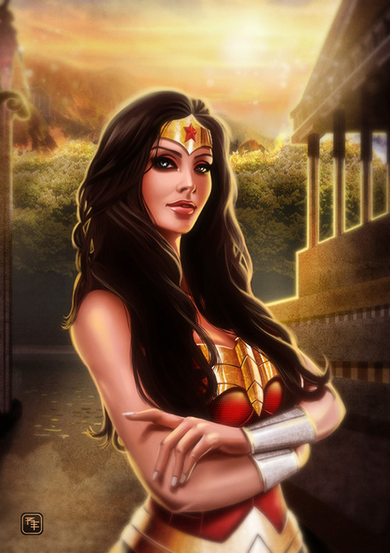
Batman vs. Wonder Woman

Slide 6
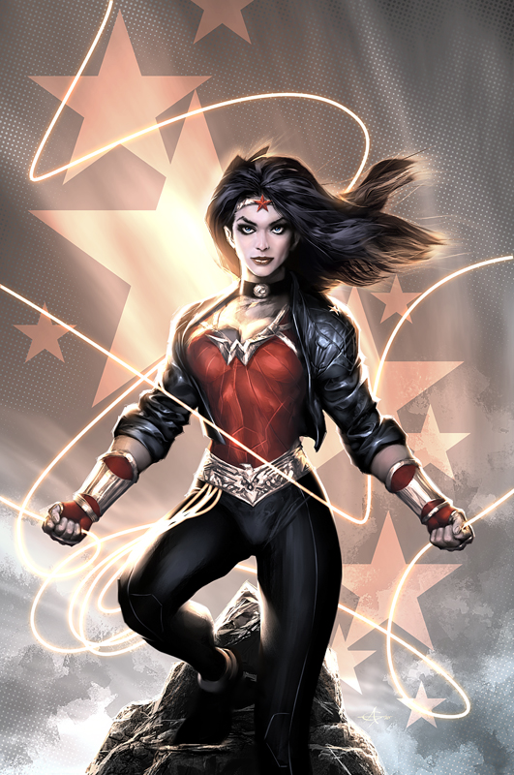
Super Quiz
Who is stronger- Batman or Wonder Woman?
True or False- Both Superman and Wonder Woman can fly.

Slide 7
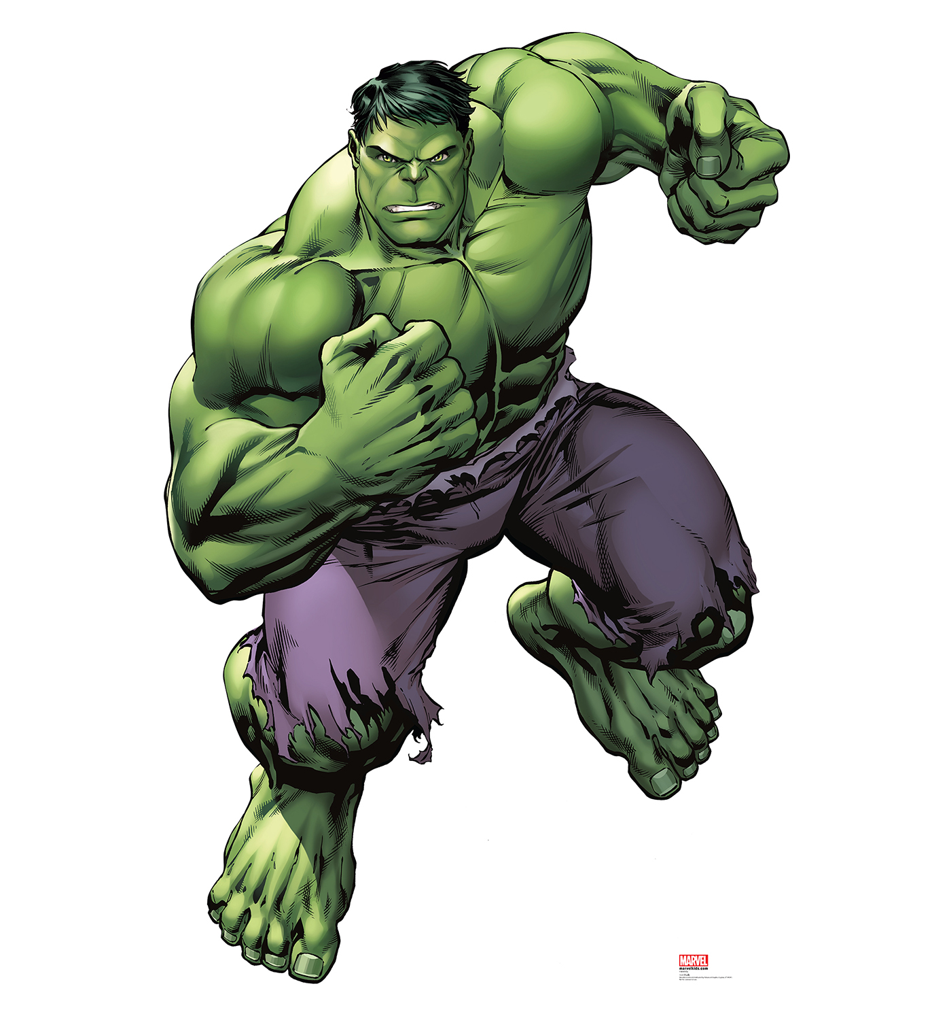
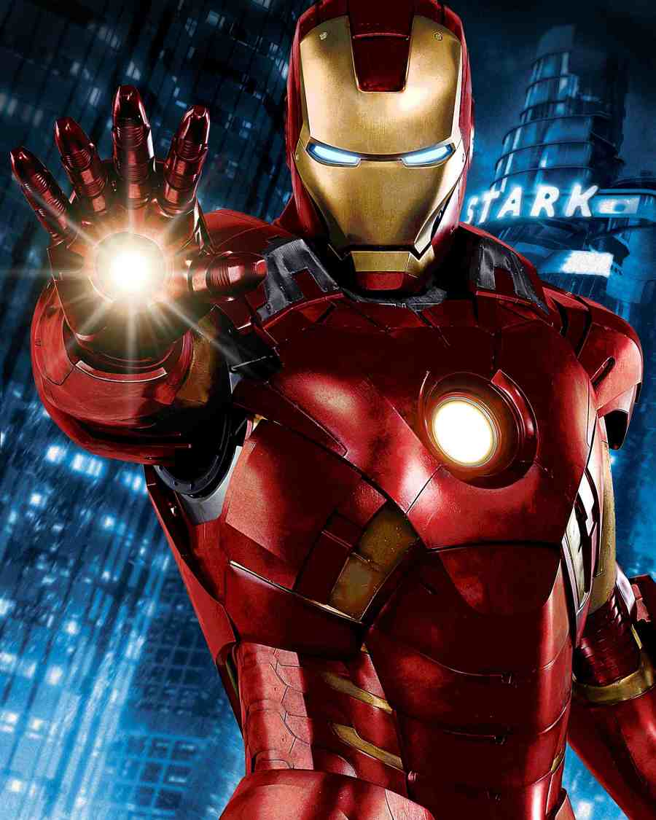
Iron Man vs. The Hulk

Slide 8
Super Challenge
True or False- Iron man is a robot.
Who do you think is stronger- The Hulk or Superman?
In a fight between Iron Man and Batman- who would win?
Which superhero do you think has the best super powers?
If you could be a super hero, who would you choose?

Slide 9
Practice English with Superheroes
Superman has super strength and super speed.
Batman is rich and drives the coolest car.
Wonder Woman is stronger than Batman.
Both Superman and Iron Man can fly.
Iron Man is not a robot.
The Hulk is green and is the largest superhero.

Slide 10
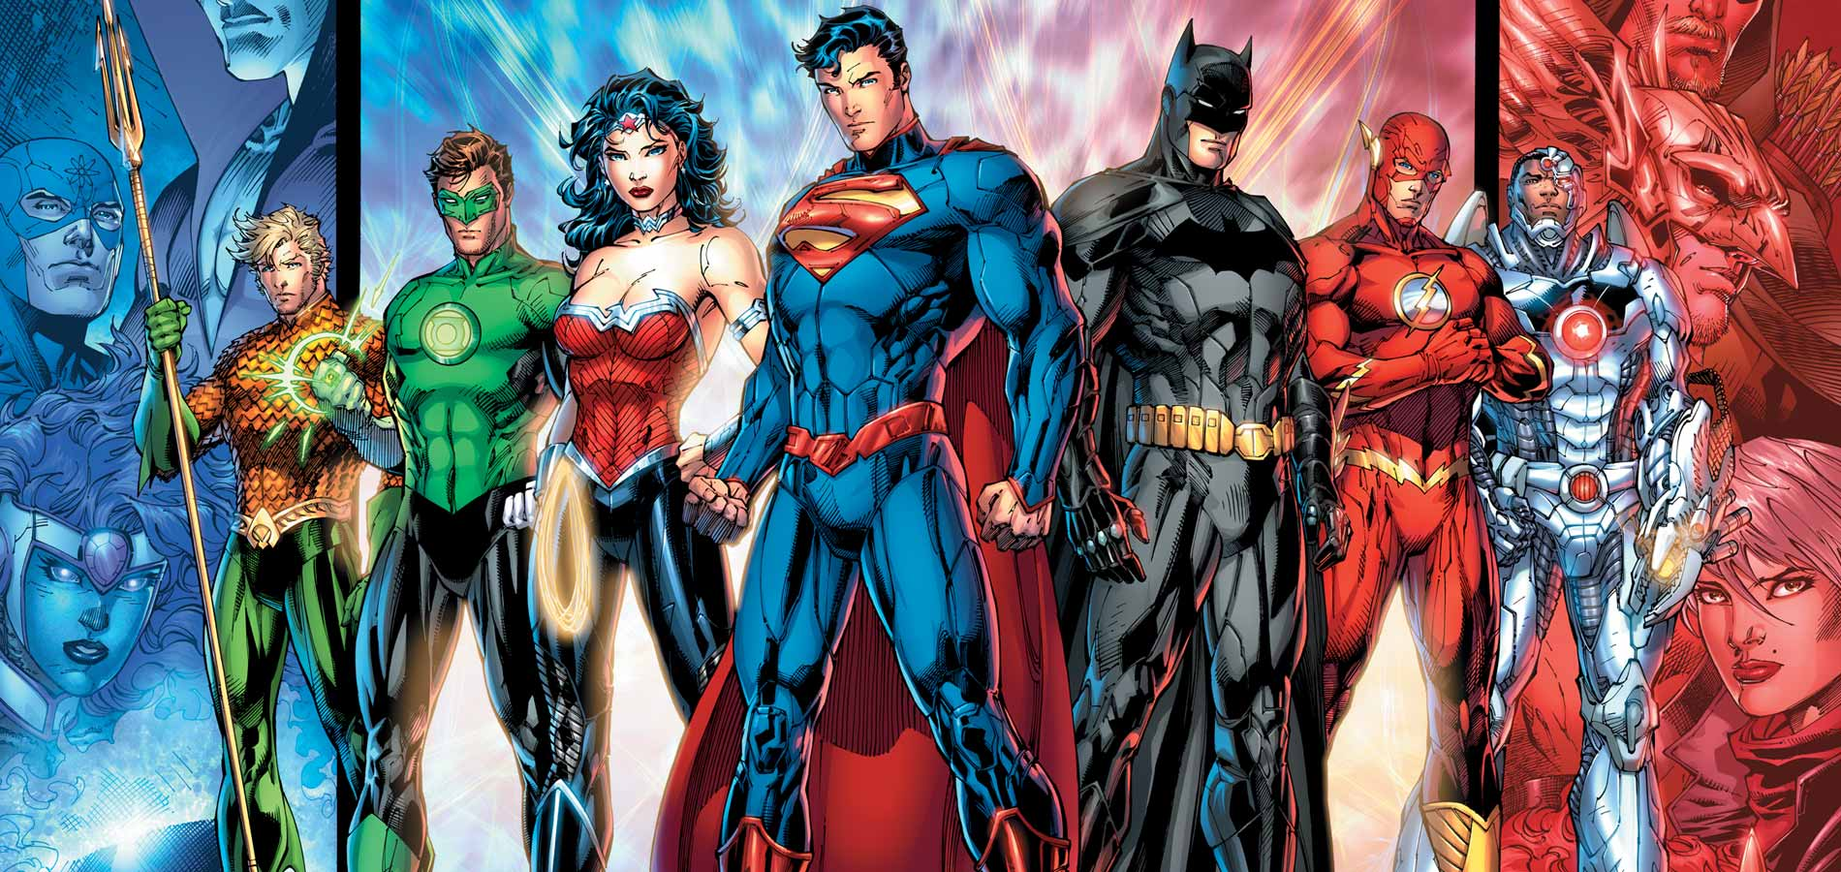
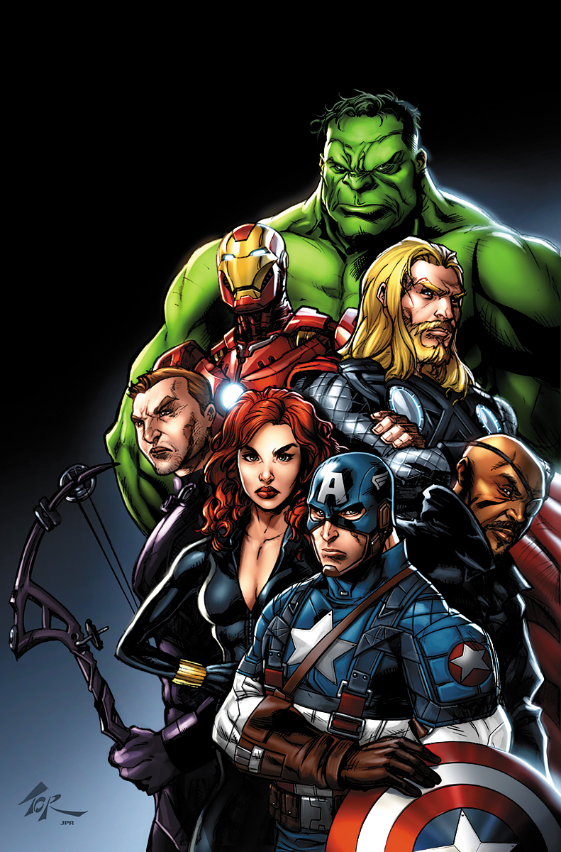
Superheroes are a Great Way to Learn English

Slide 11

American English Pathway
ESL Beginner Language Series
Property of American English Pathway
Copyright 2018

