Slide 1

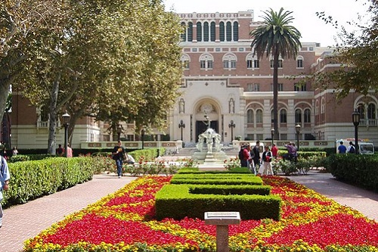
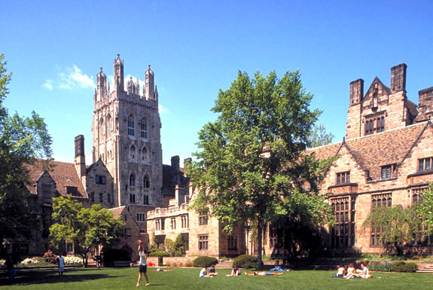

Understanding the American System
What Makes an American Education Different

Slide 2

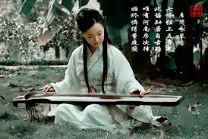
What is Valued in Japan?
Tradition
Community
A National Perspective

Slide 3
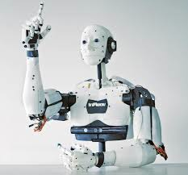

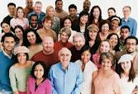
What is Valued in The United States
Innovation
Creativity
Imagination
Individualism
Differences are Celebrated
Pioneering Spirit
Diversity of Thought
All perspectives are values
Avoiding Group Think

Slide 4
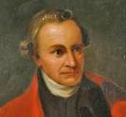
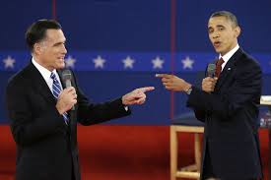

Freedom of Expression
Patrick Henry “Sir, I disagree with everything you just said, but I will die defending your right to say it”
Understand this one sentence- and you have mastered half of American culture.
Debate is the cornerstone of any democracy.
In the classroom, debate is encouraged.
Ask questions-feel free to disagree.
The job of a teacher, is not to fill a vessel, but to light a flame.
Chinese classrooms try to fill a vessel. American classrooms try to light a flame.

Slide 5
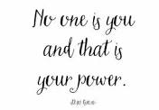
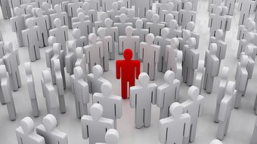
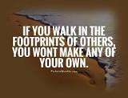
Individualism
You are unique and special- no one has a right to force you to change
You must also respect the individuality of other- you have no right to force them to change

Slide 6



Tradition vs. Innovation
Tradition
Familiar and Safe
Change is scary
Old problems
If a problem is an old one, traditional methods have failed to solve it.
New methods are required.
Innovation
New methods require NEW thinking.
New thinking requires breaking from tradition

Slide 7
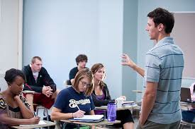

How does all this translate into the classroom?
1. Teacher-centered
2. Lecture
3. Providing Information
4. Standardized Testing
1. Student-centered
2. Debate
3. Thinking Critically
4. Argue persuasively

Slide 8
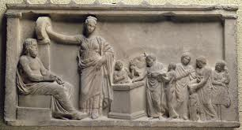
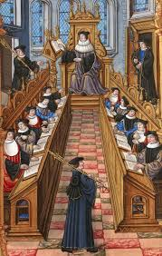
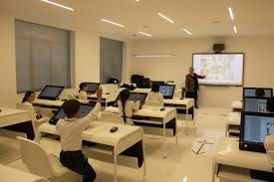
Western Education: The Legacy of Ancient Greeks
Ancient Greek classroom
Classroom from Renaissance
Modern Classroom

Slide 9

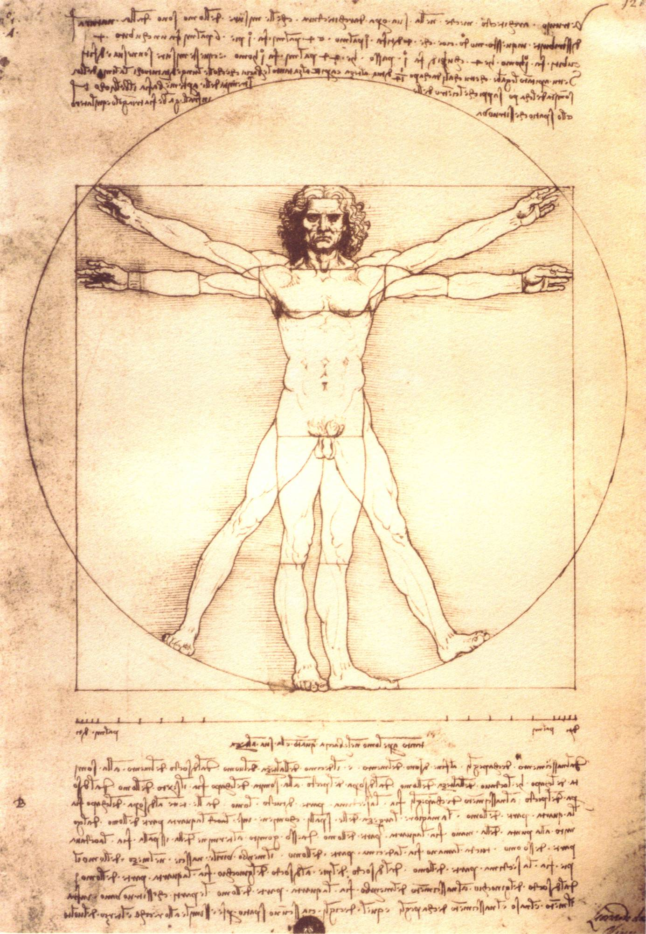


Human Existence
BODY (physical nature)
SPIRIT (subjective emotion)
MIND (rational thought)

Slide 10
The Ancient Greeks To maximize potential- A student must: Develop Everything
Discipline the mind
(logic, mathematics, science)
Develop the body
(sports, exercise, health)
Strengthen the Spirit (philosophy, ethics, art)

Slide 11
Exposure to multiple disciplines
See the world from multiple viewpoints
Have the ability to analyze and interpret
Become a free thinker

Slide 12
What do these three men have in common?
Creator of Microsoft
Creator of Apple Computers
and
I Phones
Discovered the Theory of Relativity

Slide 13
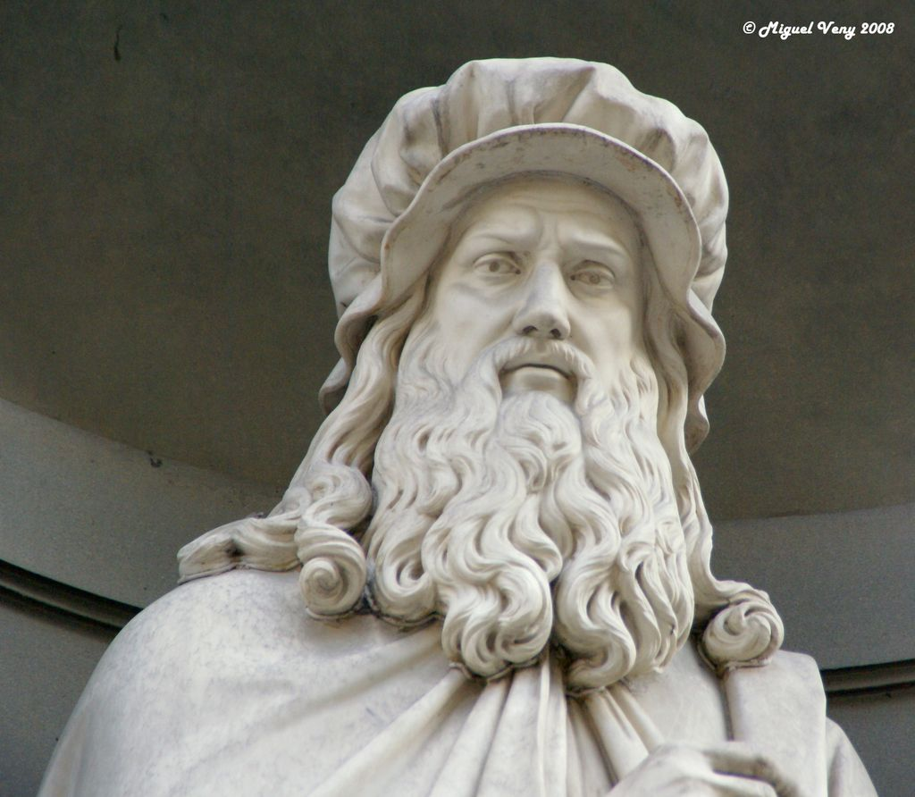
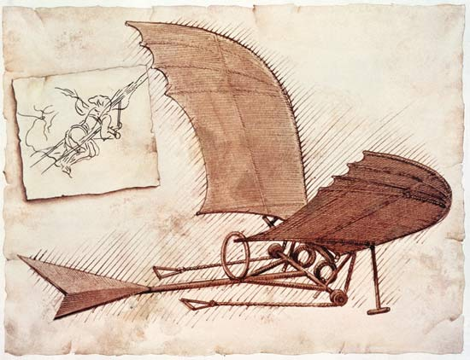
They Solved Problems
Critical thinker
Innovative thinker
Creative thinker

Slide 14
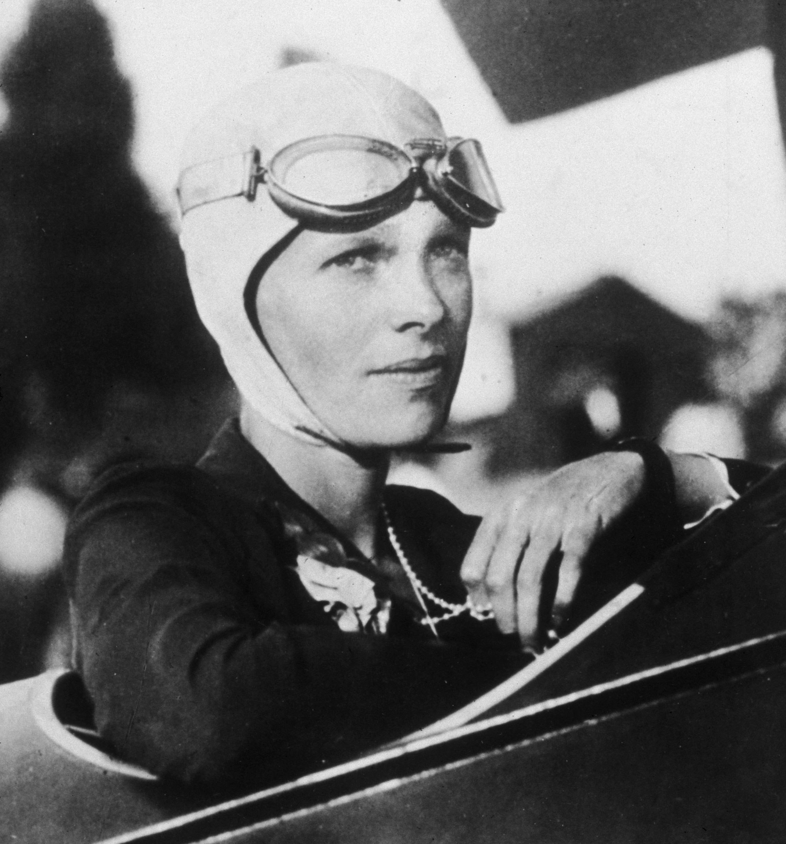
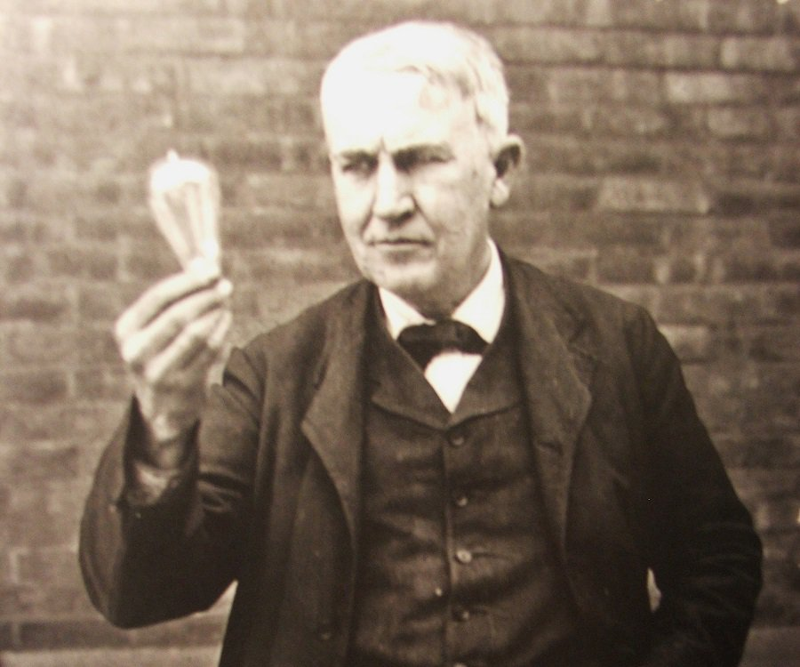
Break Boundaries
Old problem require new perspectives
Reject
group think. Follow your instinct even when everyone else says you’re wrong
Free Thinker
No one tells you what to believe.

Slide 15
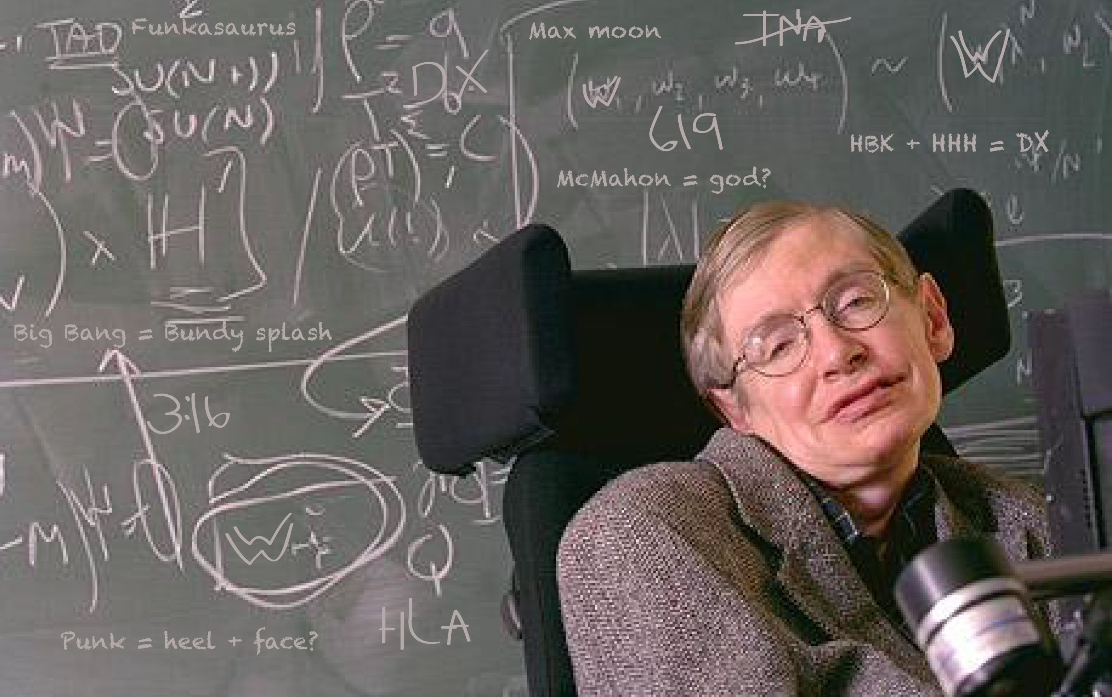
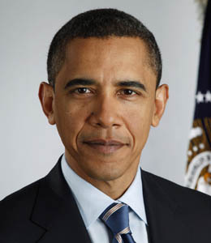
Change the World
Refuse to be ordinary
Refuse to accept limits
Focus on the future by understanding the past- not by living in the past
Refuse to be silent

Slide 16
“If I see further than others, it’s because I stand on the shoulder of giants”
Sir Isaac Newton
Discovered the theory of gravity
Hippocrates
Founder of modern medicine
Aristotle
Father of Physical Sciences

Slide 17
No Limits
Critical Thinker
1. Question everything 2. Analyze from multiple perspective 3. Understand what works and what doesn’t
Free thinker
Develop an understanding build on knowledge that is both broad and deep
Creative Thinker
Heightened awareness- you see things others fail to see
Free from the old thinking- the ability to see thing from new perspectives
Combine intelligence and imagination
Free from the opinions of others- can see their strengths and weaknesses

Slide 18

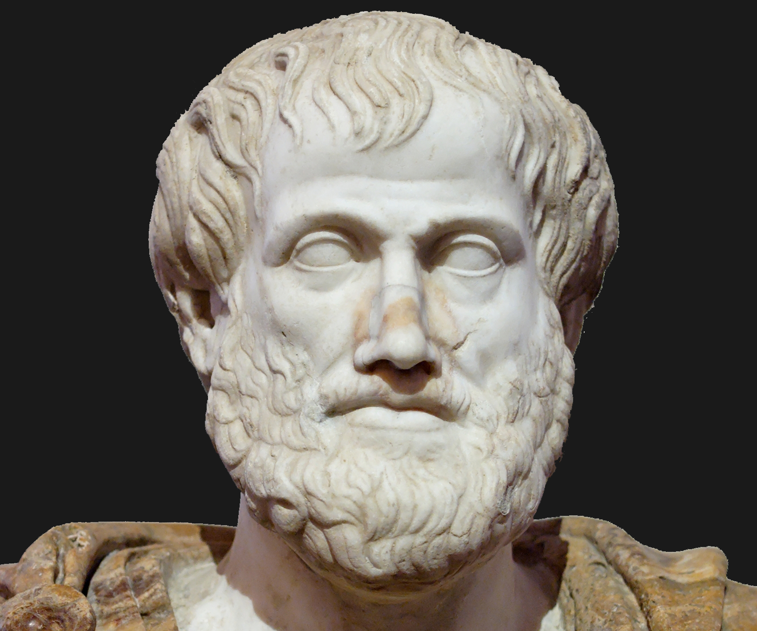

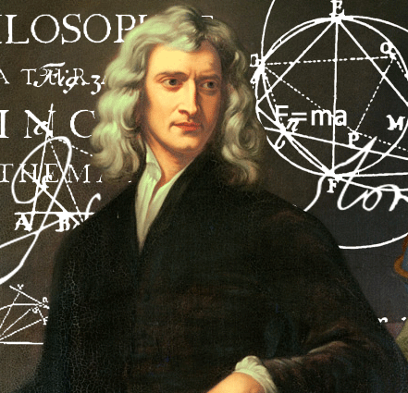
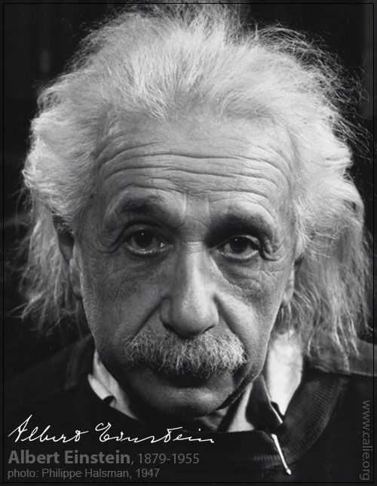
American Education- lighting the fire within.

Slide 19

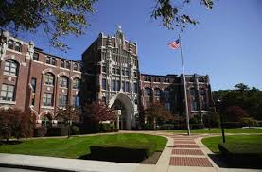
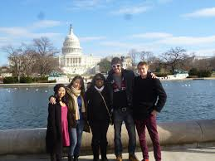

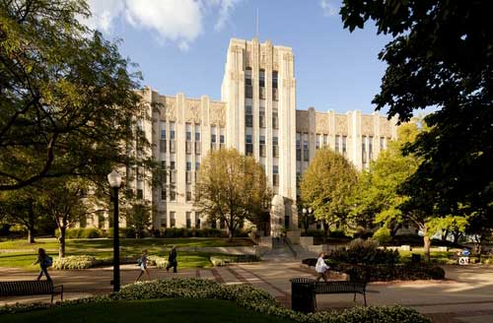

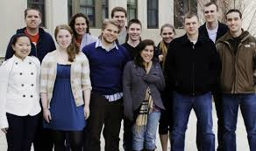
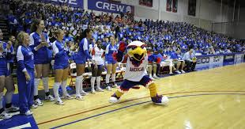

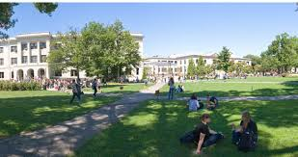
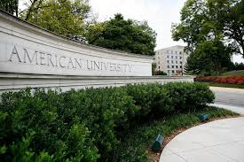
How to Apply to an American University
Fill out an application
Send in copy of passport
Send in high school transcripts
Send in copy of financial records
Send in TOEFL, IELTS, or SAT results

Slide 20

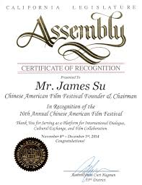
Additional Requirements
Letters of Recommendation
Written Essay
Award or Certificates of Participation

